Slide 1
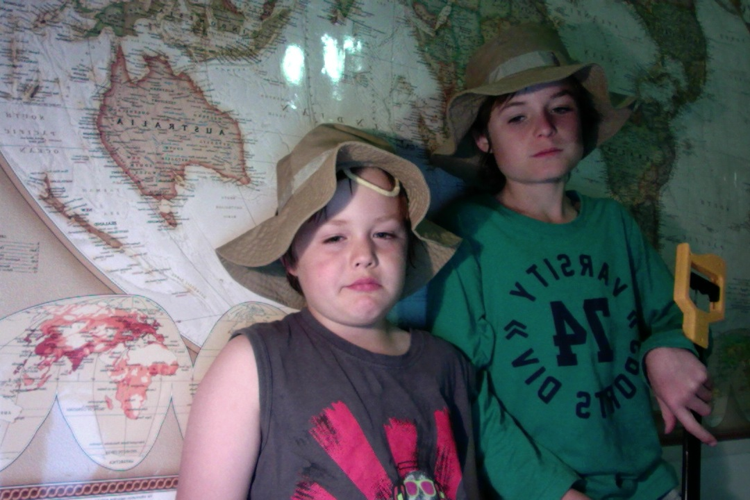
Sydney to Perth – an exploration for new specimens of plants and animals
Brunt Boys Exploration

Slide 2
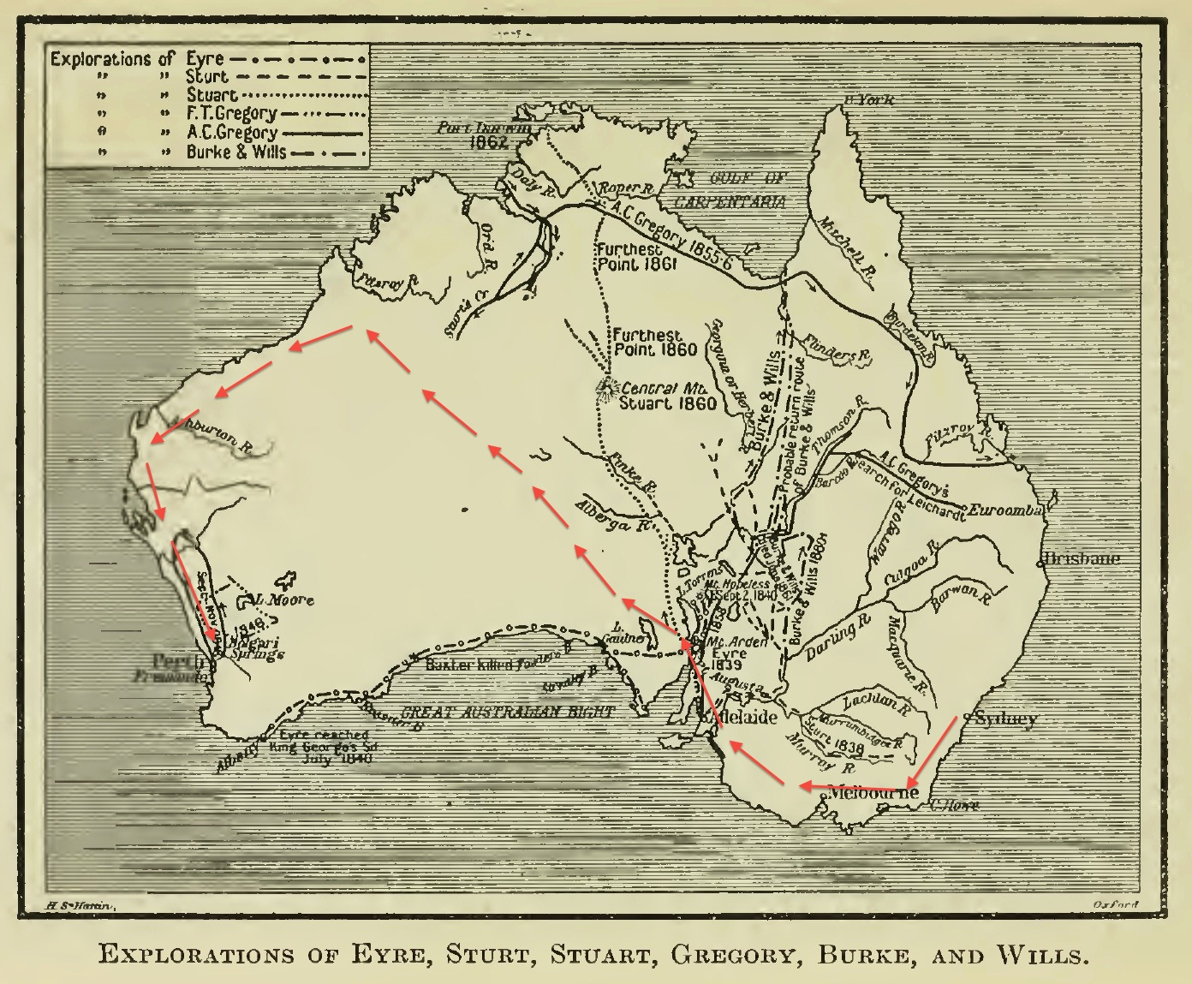
Our exploration
The Brunt Expeditions aim is to cross the continent of Australia from Sydney on the east coast to the west coast, which is uninhabited by the migaloo (white-fella). No one has done this before, some parts of the centre of the continent is unknown, unmapped and unexplored.
We are naturalists looking to discover new plant and animal specimens. Im a botanist and my brother is a zoologist. We hope to find new plants that could make new food crops, medicines, new fibres like cotton and new timbers to build with.

Slide 3
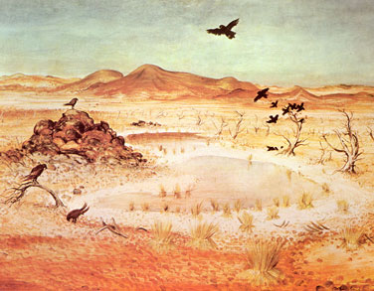
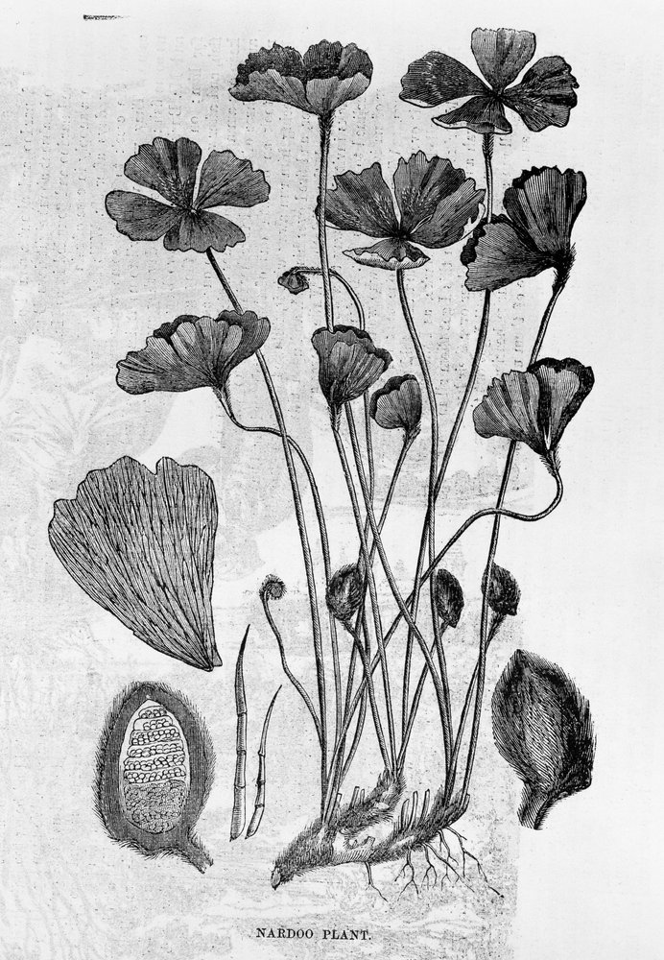
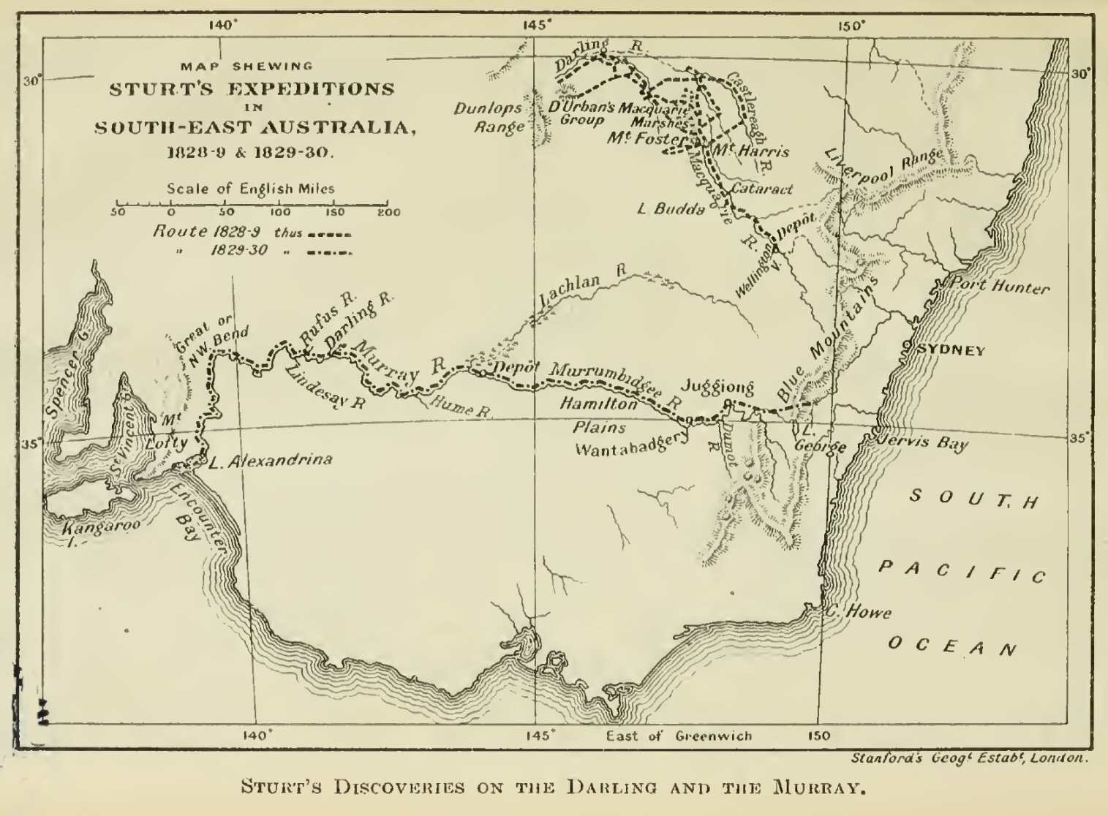
What we know about it.
Its hot, dry and little water will be available.
We know that Burke and Wills ended up poisoning themselves by eating the plant known as Nadoo. They thought it was ok to eat because they had seen the aboriginals eating it, but they didnt prepare it properly and ended up slowly killing themselves. That is why we plan to take Aboriginal people with us to help us identify plants and animals we can eat safely and where we can find water.
From other explorers we have learnt Lessons
We have some maps from previous explorers like, Sturt and Burke and Wills of places they have explored and know what to expect in those areas. Some lessons from others are don’t eat plants what could kill you, take camels not horses because camels last longer without water. Listen, learn and be respectful of the aboriginal people as they are the original custodians of this land and know it better than we do. The Aboriginal people were here 40,000 years before white settlers and know the country better than any.

Slide 4
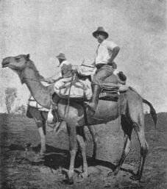
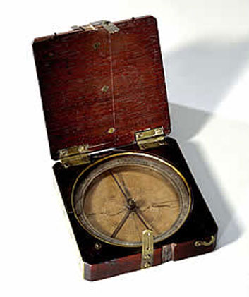
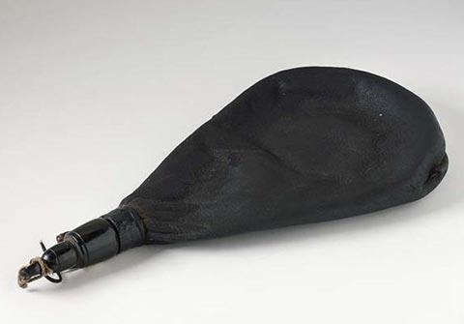
Supplies and equipment
Water
Food supplies
Camels
Sleeping equipment
Clothing
Medical supplies
Compass, telescope, binoculars
Memo pads and pencils
Food for camels
Tents
Guns
Pack saddles
Rope and twine
Carpenter tools, shovels and axes
Water containers

Slide 5
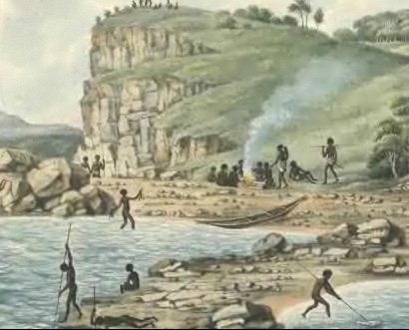
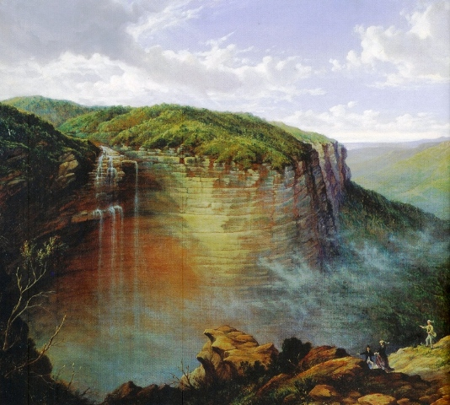
When and how we will travel
We will set off in winter when it is cooler. We will be traveling on camels because we know its very hot and they last longer without water. Camels are adapted to living in the desert – their feet have elastic but tough soles that prevent them from sinking into the sand, hair on their head and hump regulate their body temperature, and a hump that stores food for when they need it. They can survive for up to five weeks without food and for four to six days without water.
We will be taking aboriginal men with us to help guide and hunt. They will also take us on aboriginal tracks known as native paths – they are tracks that have been walked for thousands of years.
How many people we will take
I will be taking 8 men including my brother Fynn who is a animal scientist (zoologist), two Aboriginal guides, two surveyors to map our journey, illustrator, botanist and cook.

Slide 6
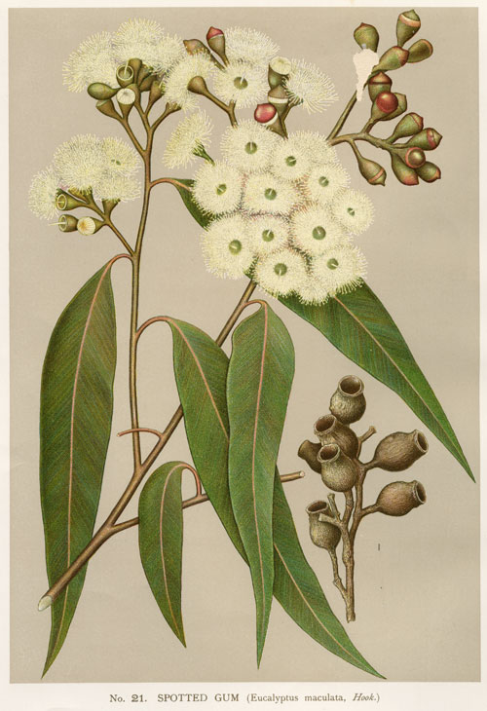
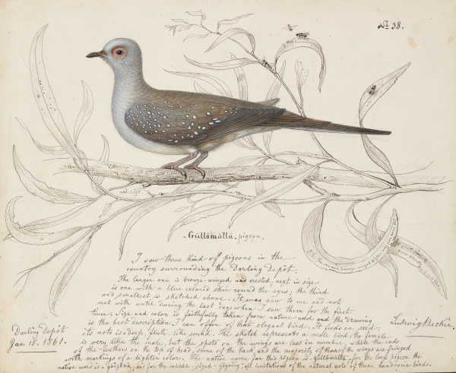
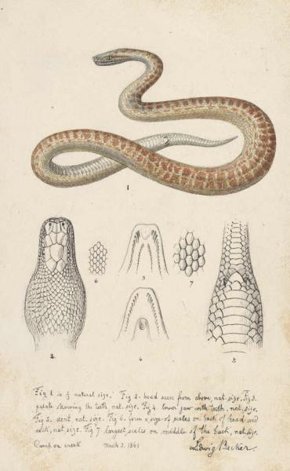
What we believe we will discover
Like explorers before us we hope to find new specimens of plants and animals for our scientific works and record and draw them. We will collect specimens, preserve them and bring them back with us for further investigation.

