Slide 1
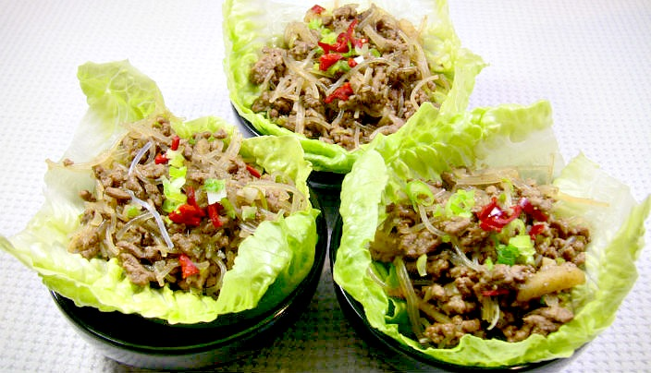
San choy bau!

Slide 2
San choy bau is a classic Chinese dish that can be found on a lot of menus.
Traditionally, its made with chicken or pork mince. The cooked meat mixture is then placed in iceberg lettuce cups and rolled up to be enjoyed.
Its very flavourful and addictive!

Slide 3
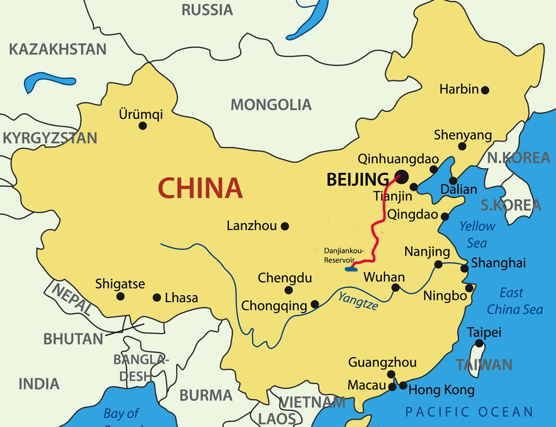
China is officially known as the People's Republic of China.
China is a huge country that stretches from Europe in the west to the Pacific Ocean in the east. It is one of the largest countries on earth, with a population of over 1.35 billion.
China belongs to the continent of Asia. Bordering countries include Bhutan, Burma, India, Kazakhstan, North Korea, Kyrgyzstan, Laos, Mongolia, Nepal, Pakistan. The summit of Mt Everest marks the border between China and Nepal.
The capital city is Beijing, while the most populated city is Shanghai.

Slide 4
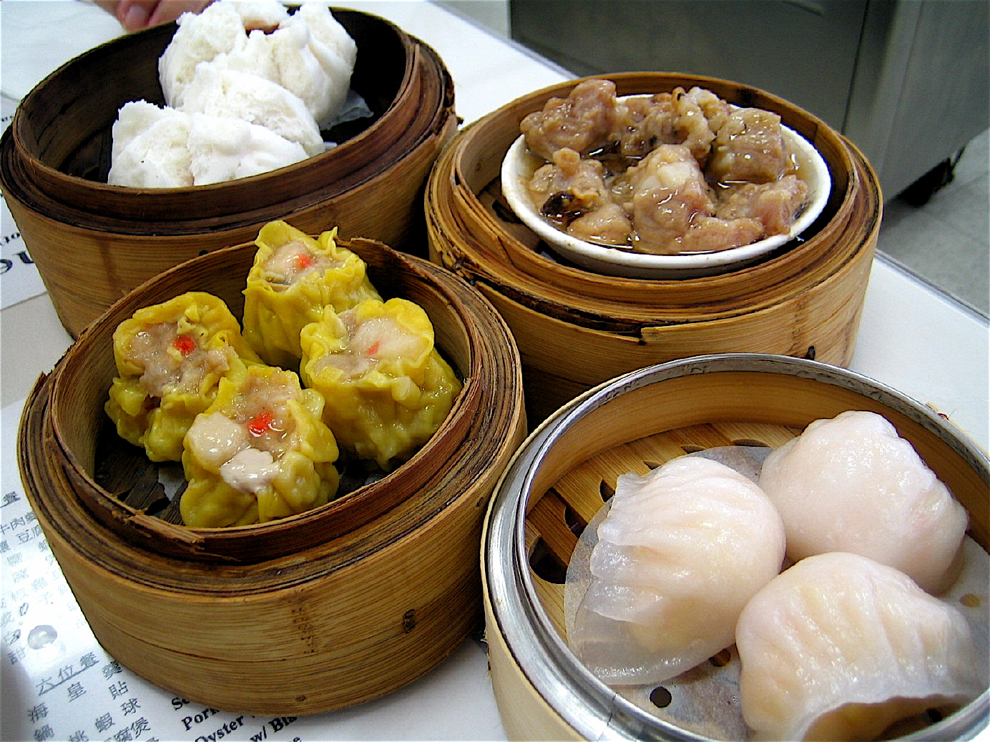
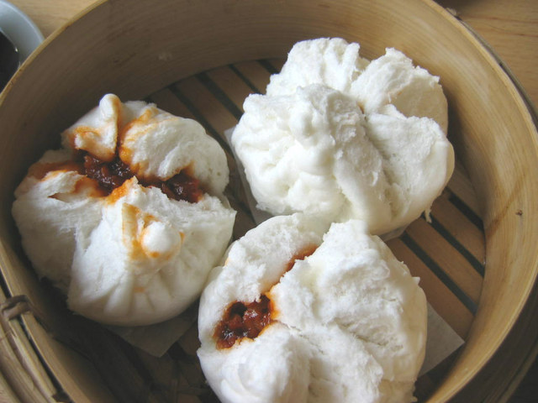
Food and Drink
Rice is the main food eaten in China.
It is important to eat together as a family in China.
Some examples of yummy Chinese food are noodles, Dim Sum, dumplings and lots of spices.
These are different types of dim sum, a cantonese specialty. Dim sum means to touch the heart.

Slide 5
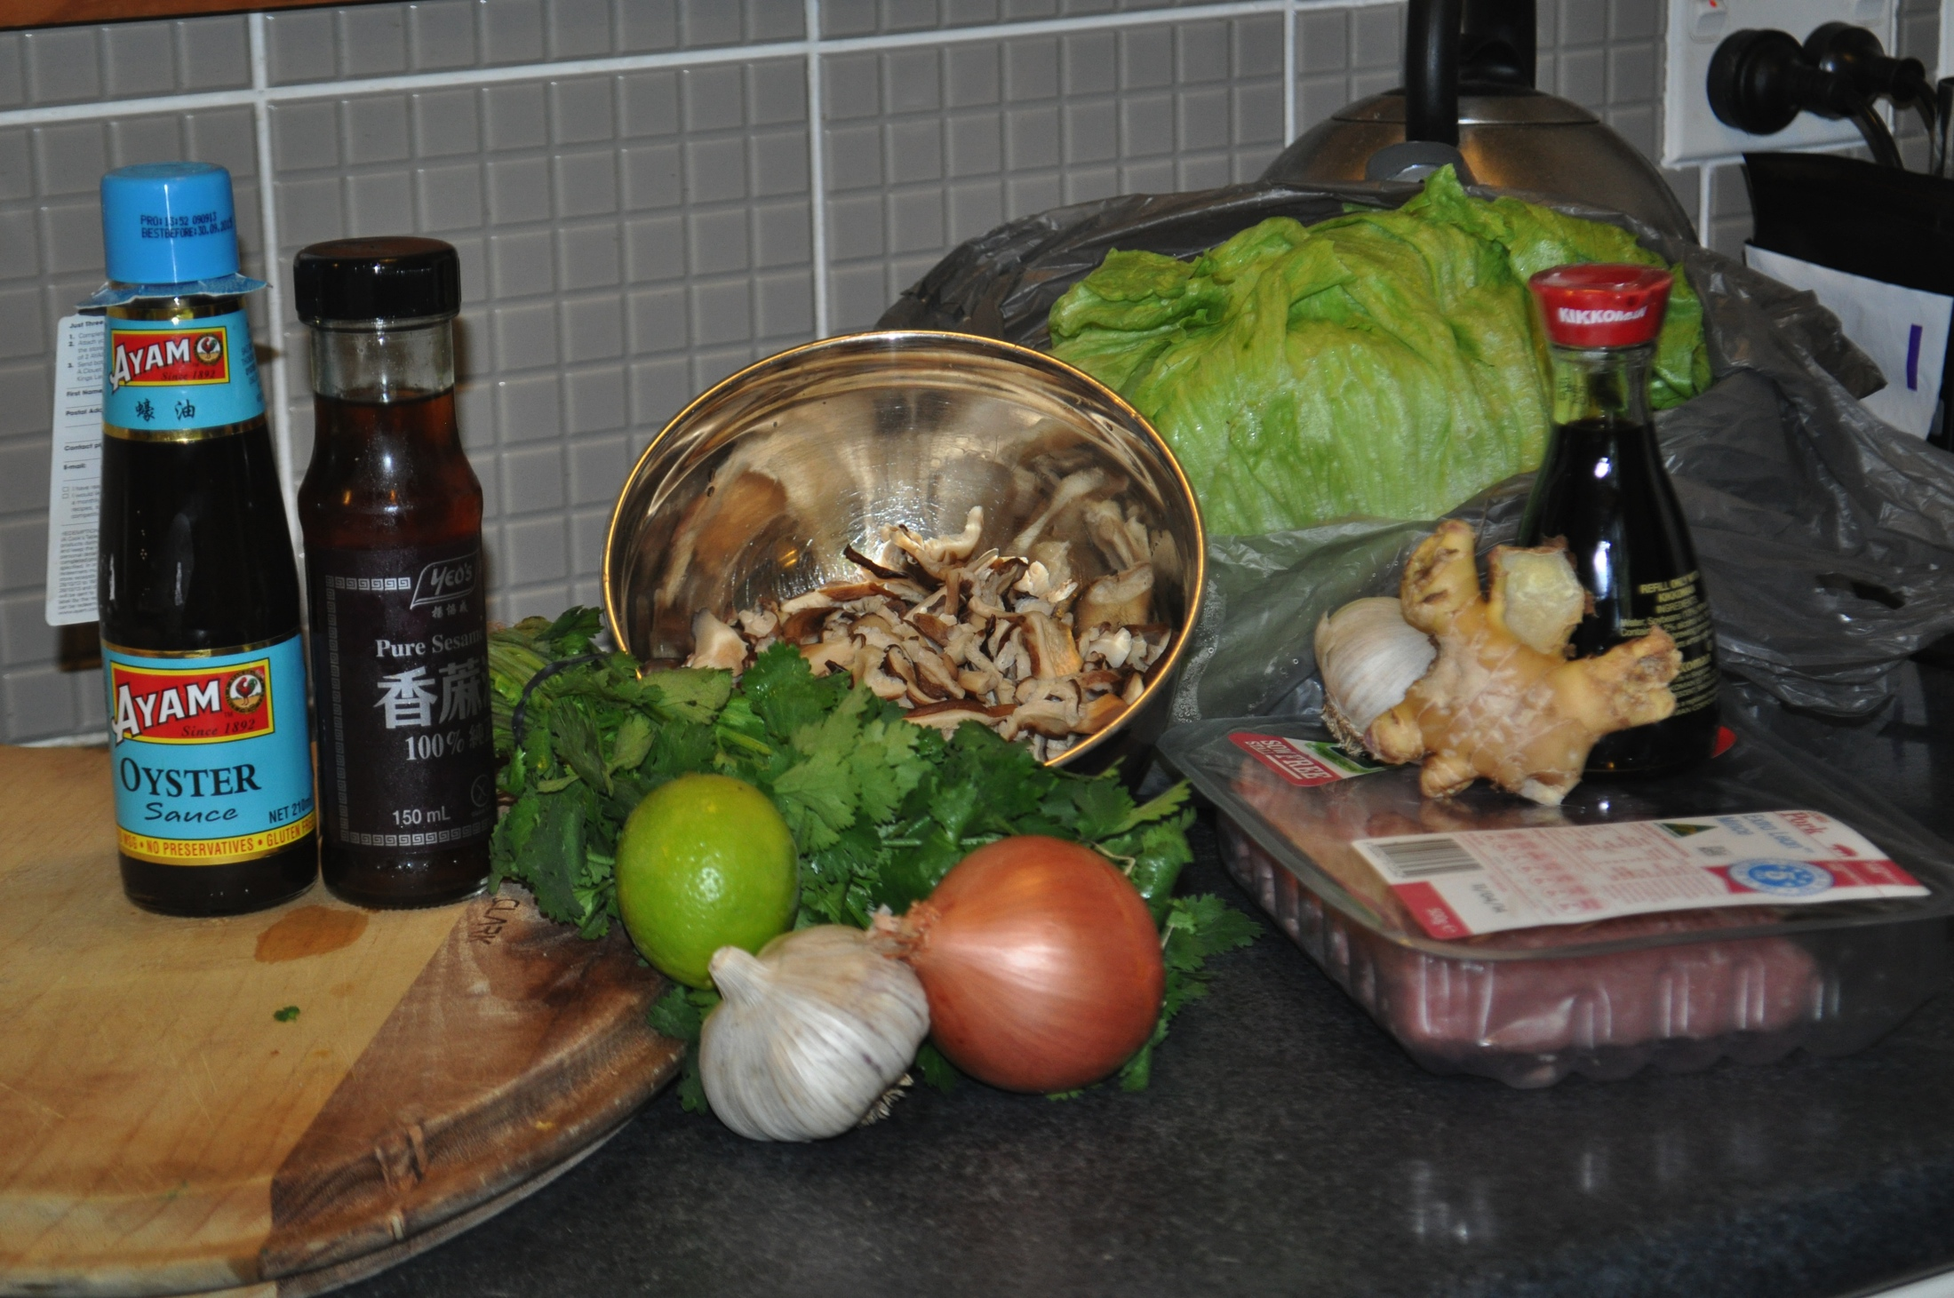
Recipe!
2 garlic cloves, crushed
4cm piece ginger, finely grated
500g lean pork mince
3 Tablespoons oyster sauce
2 tablespoon soy sauce
3 Shallots, thinly sliced
1 lime, juiced
1 teaspoon sesame oil
150 grams of shitake mushrooms
1/4 cup fresh coriander leaves, chopped
12 large butter lettuce leaves.

Slide 6
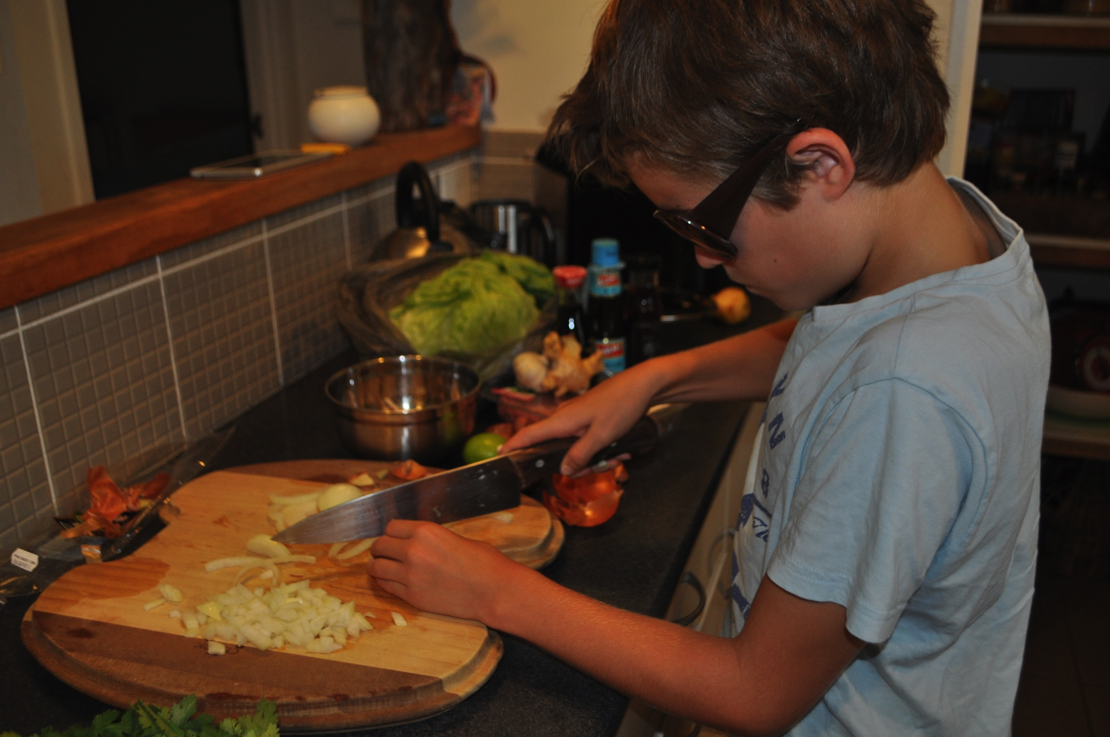
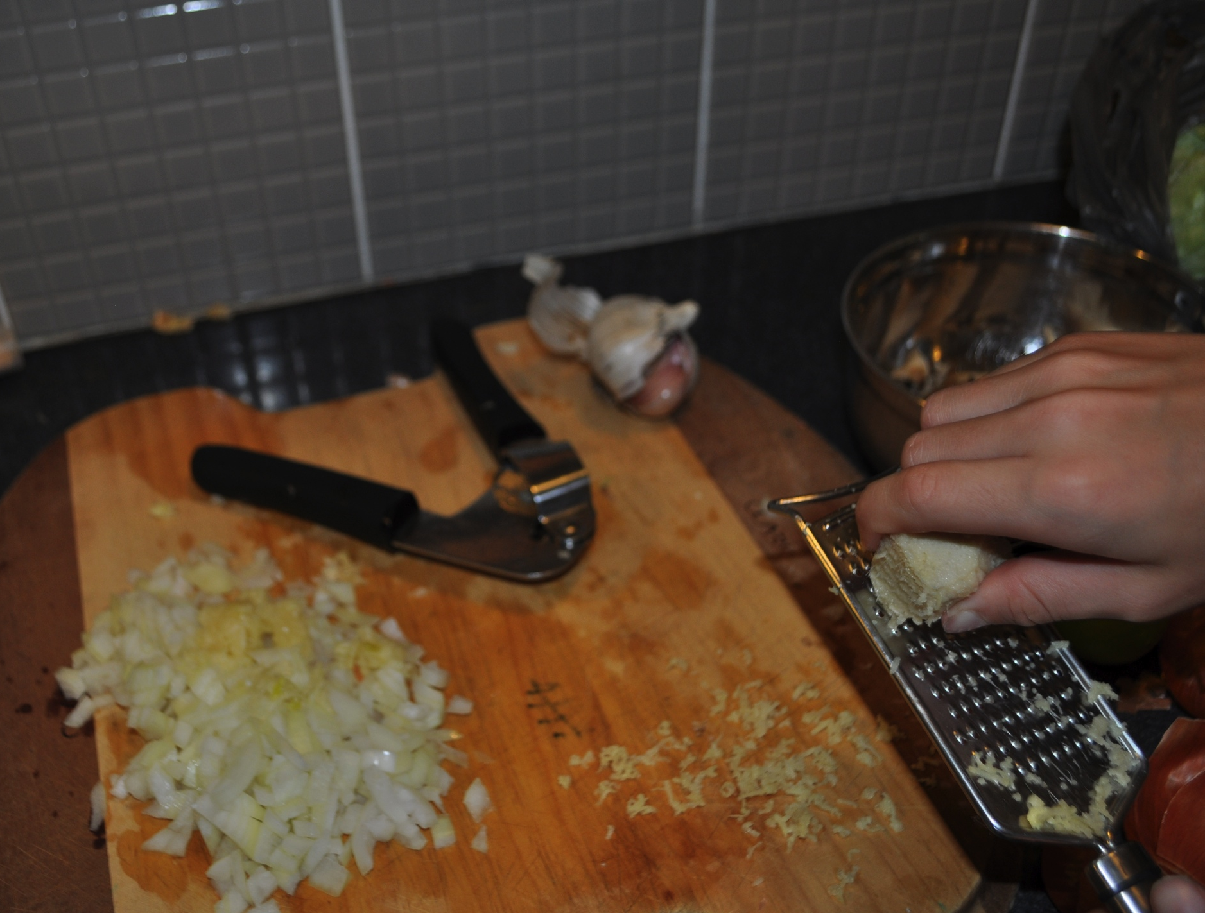
Step 1
Chop onions and shallots
Step 2
Crush the garlic and grate ginger

Slide 7
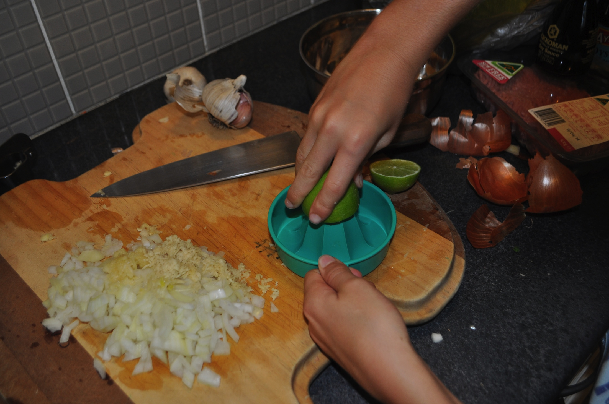
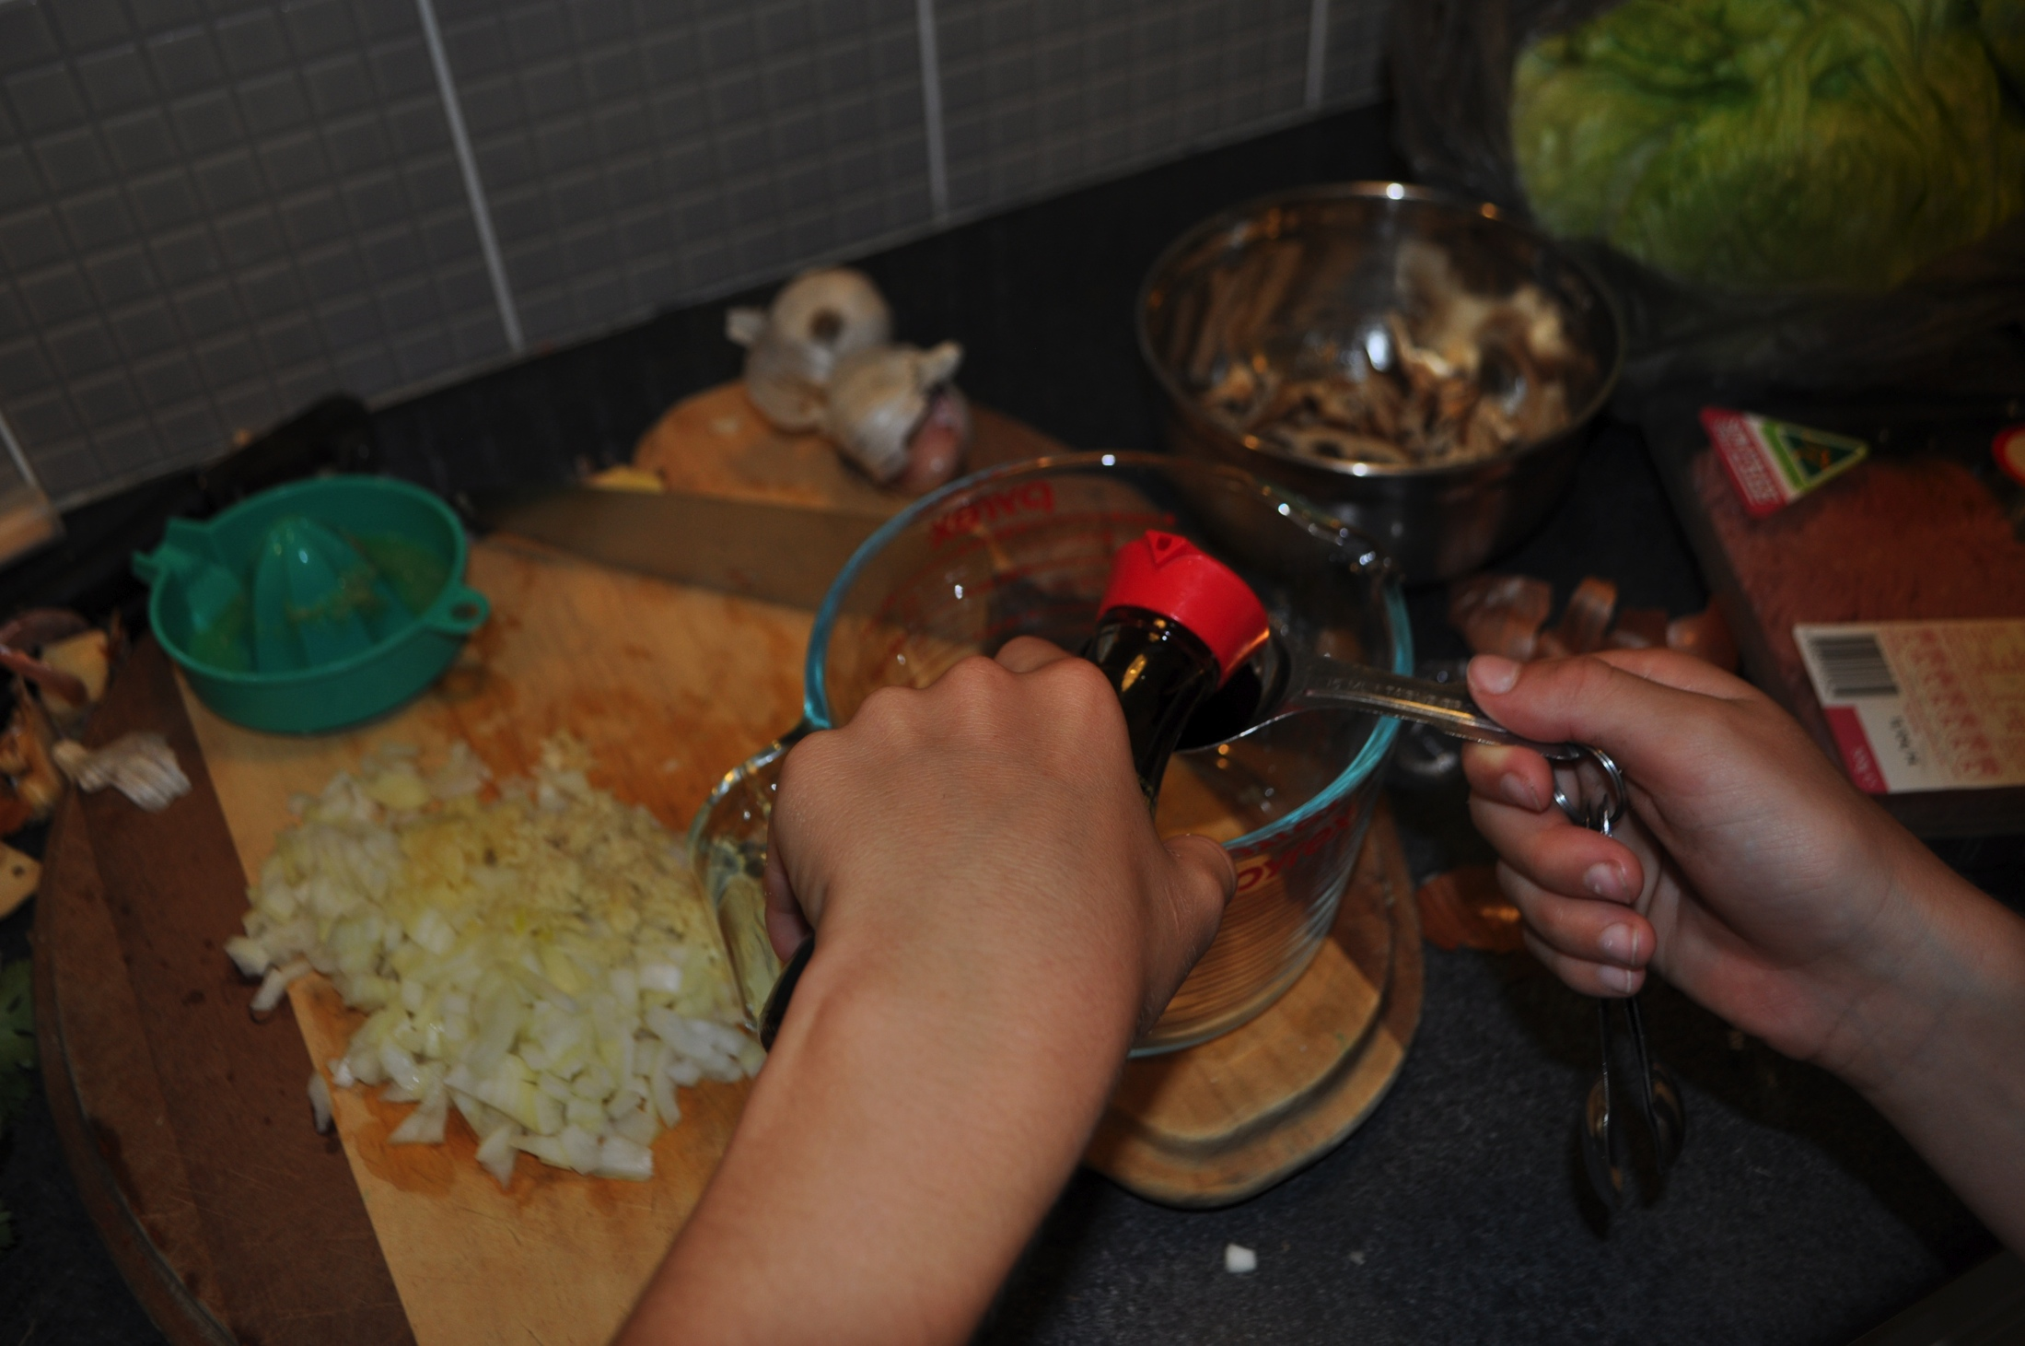
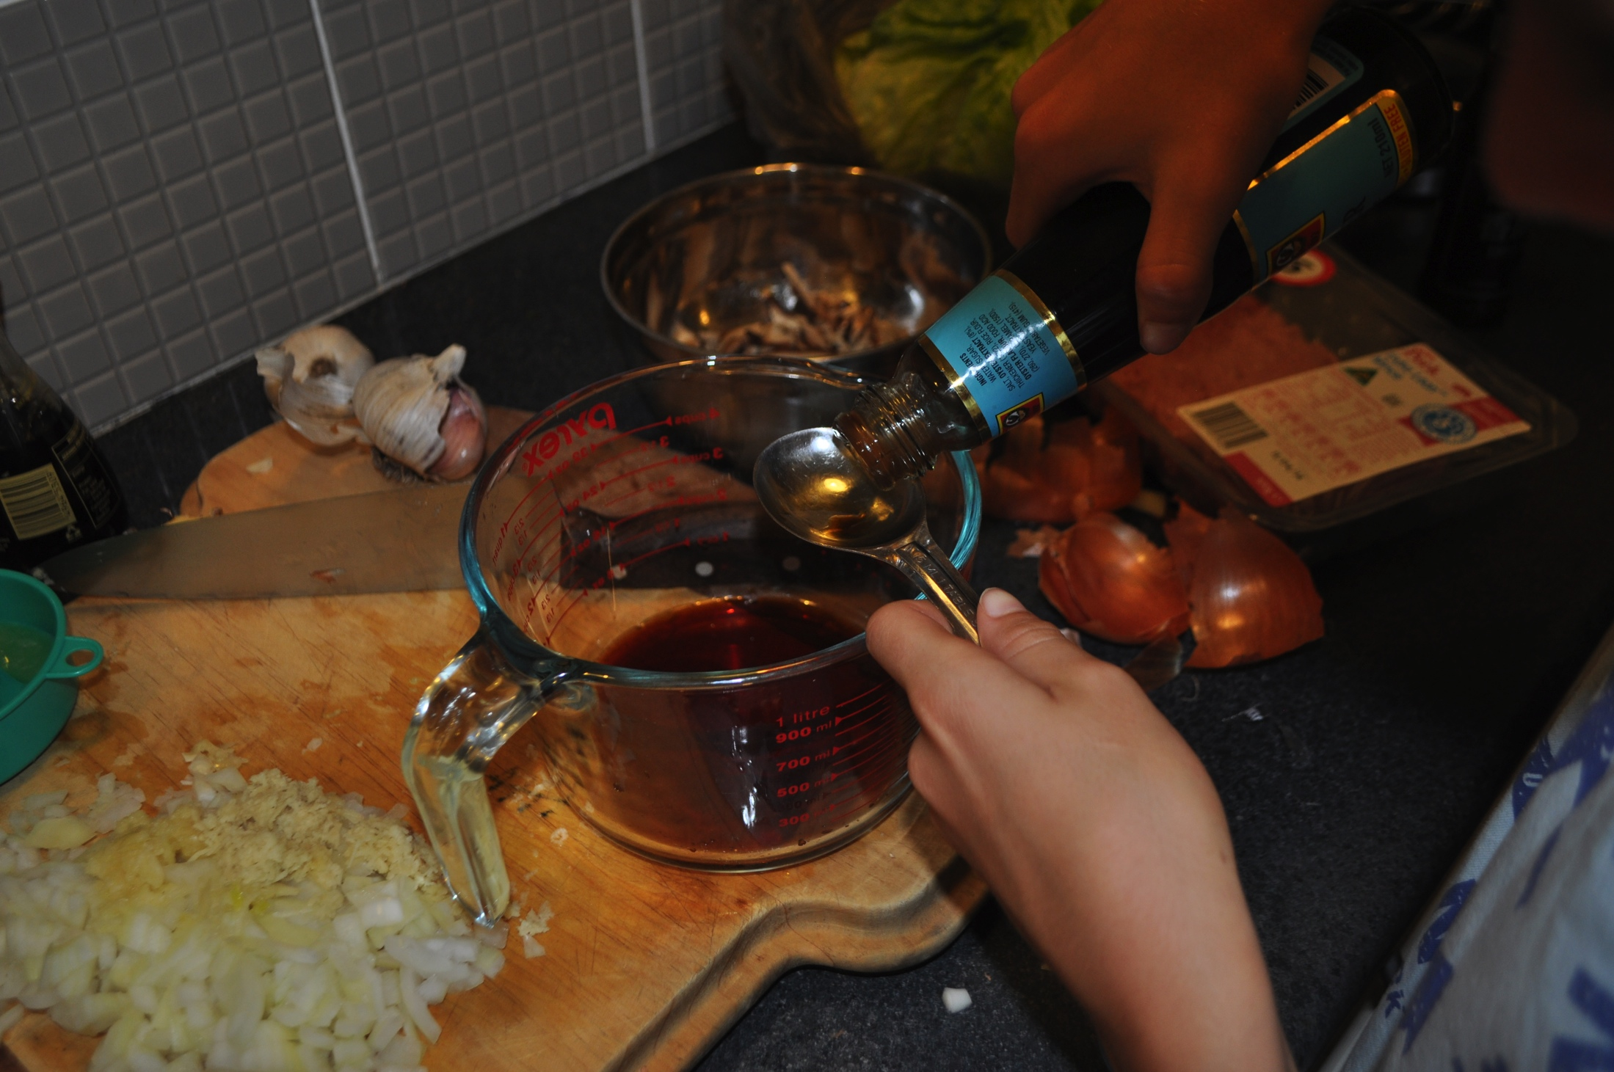
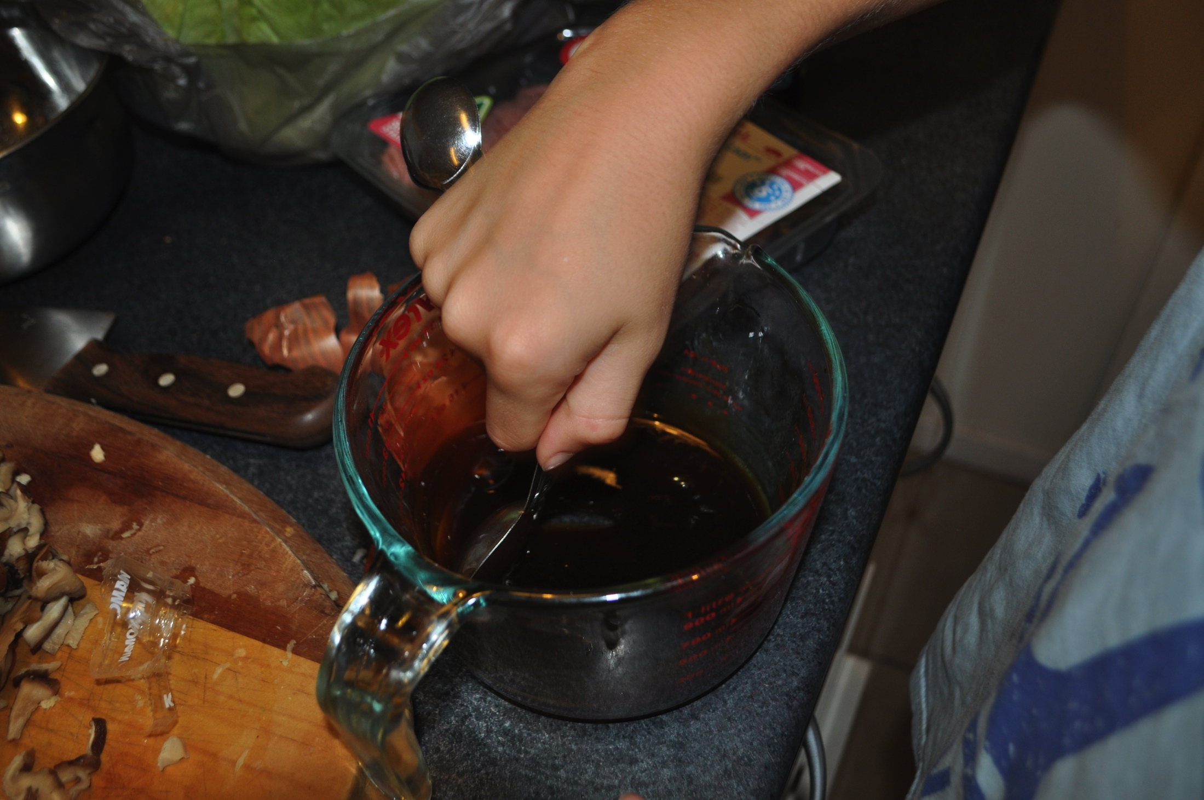
Step 3
Cut the lime in half and juice
Step 4
Pour soy sauce, sesame oil and oyster sauce
into jug and mix together

Slide 8
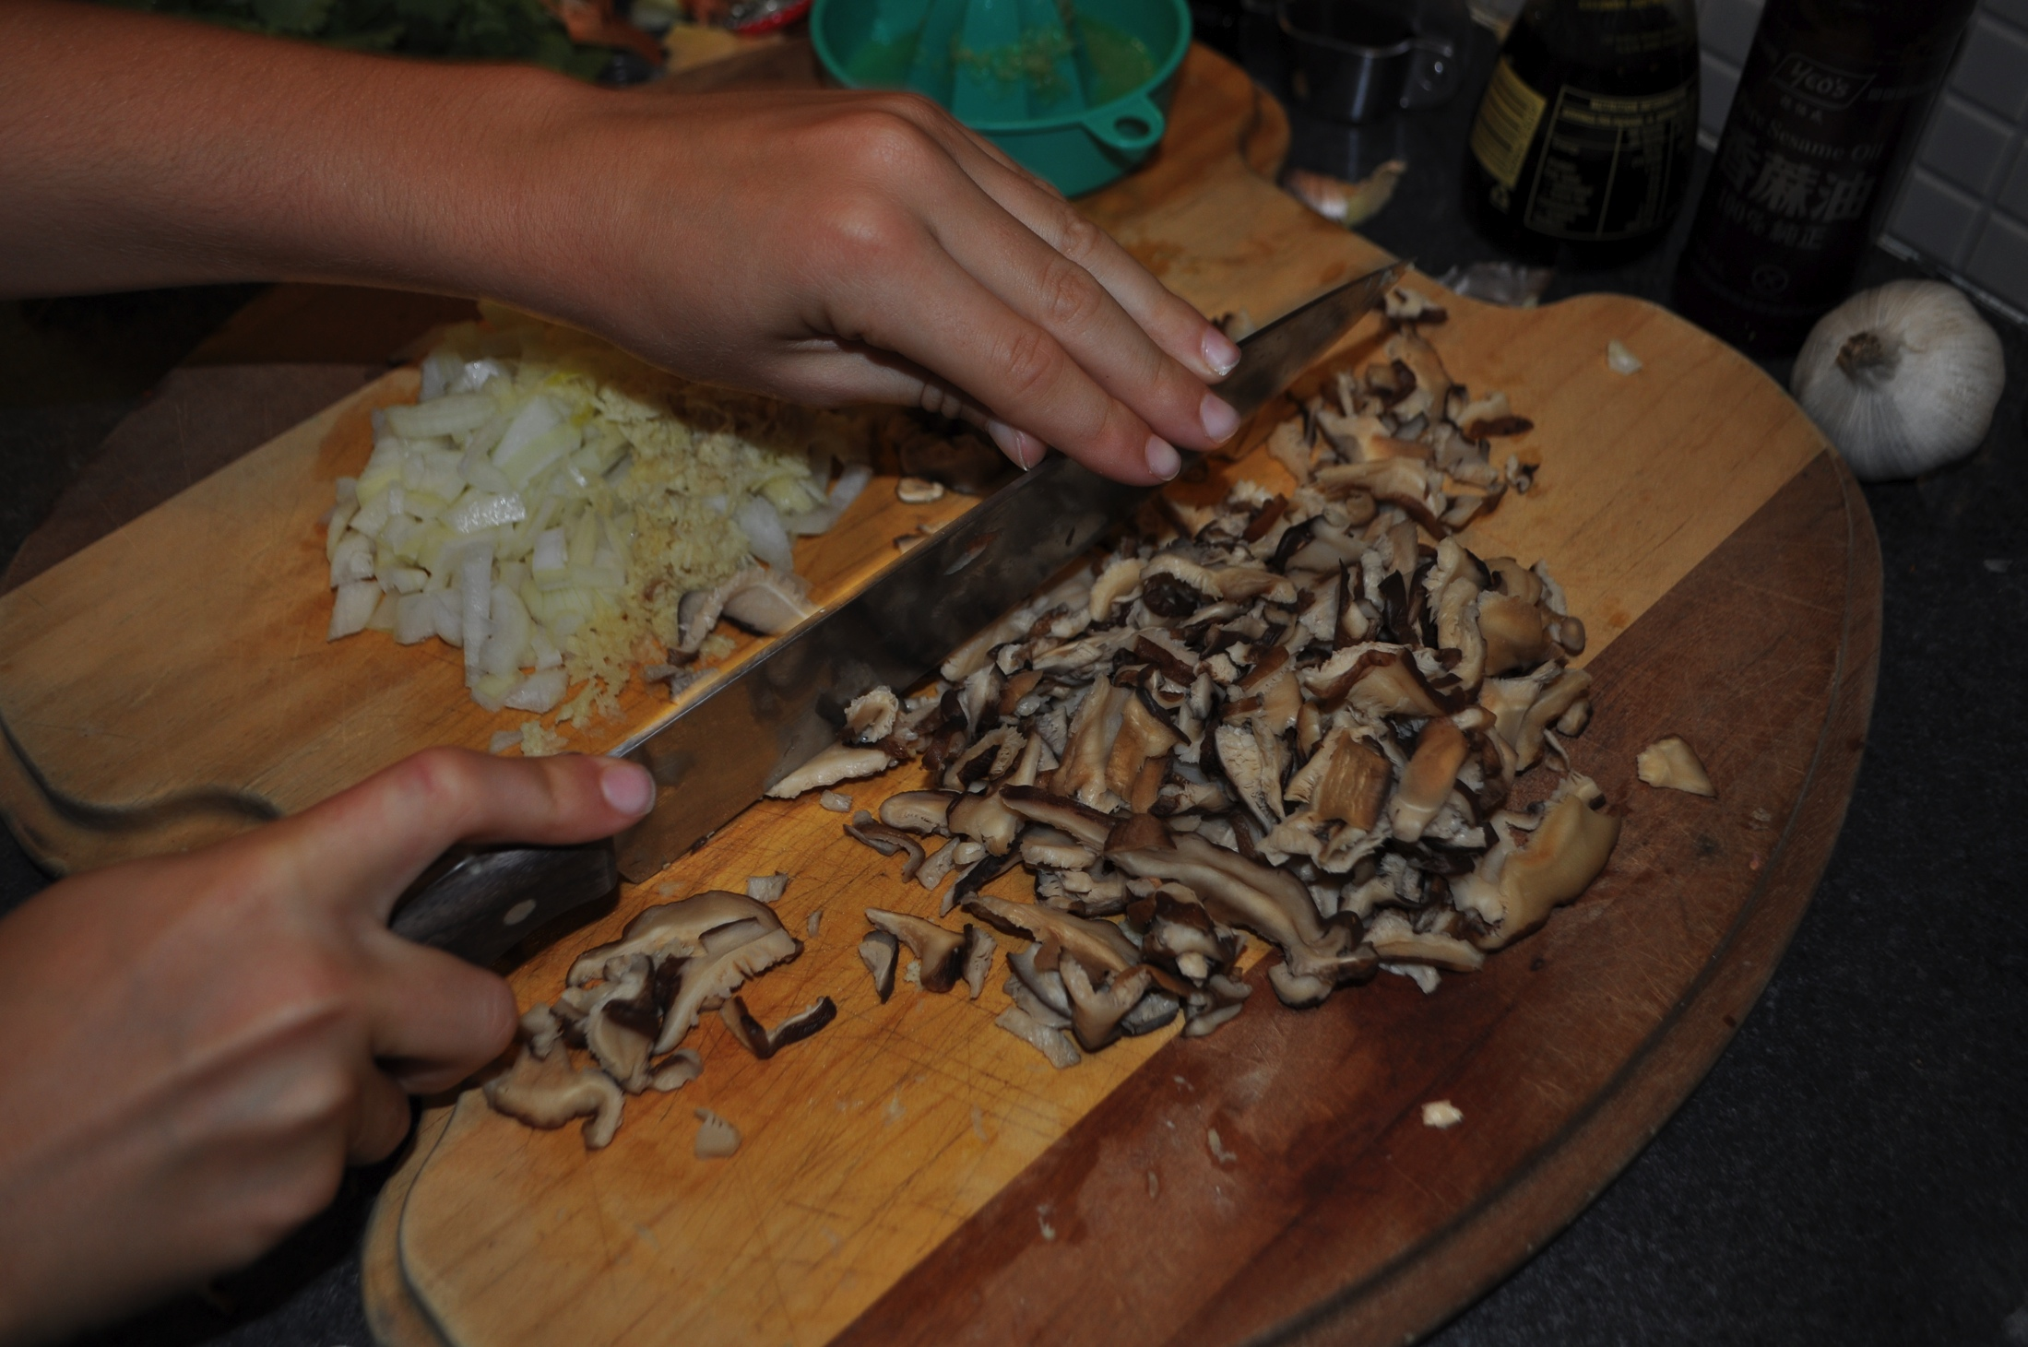
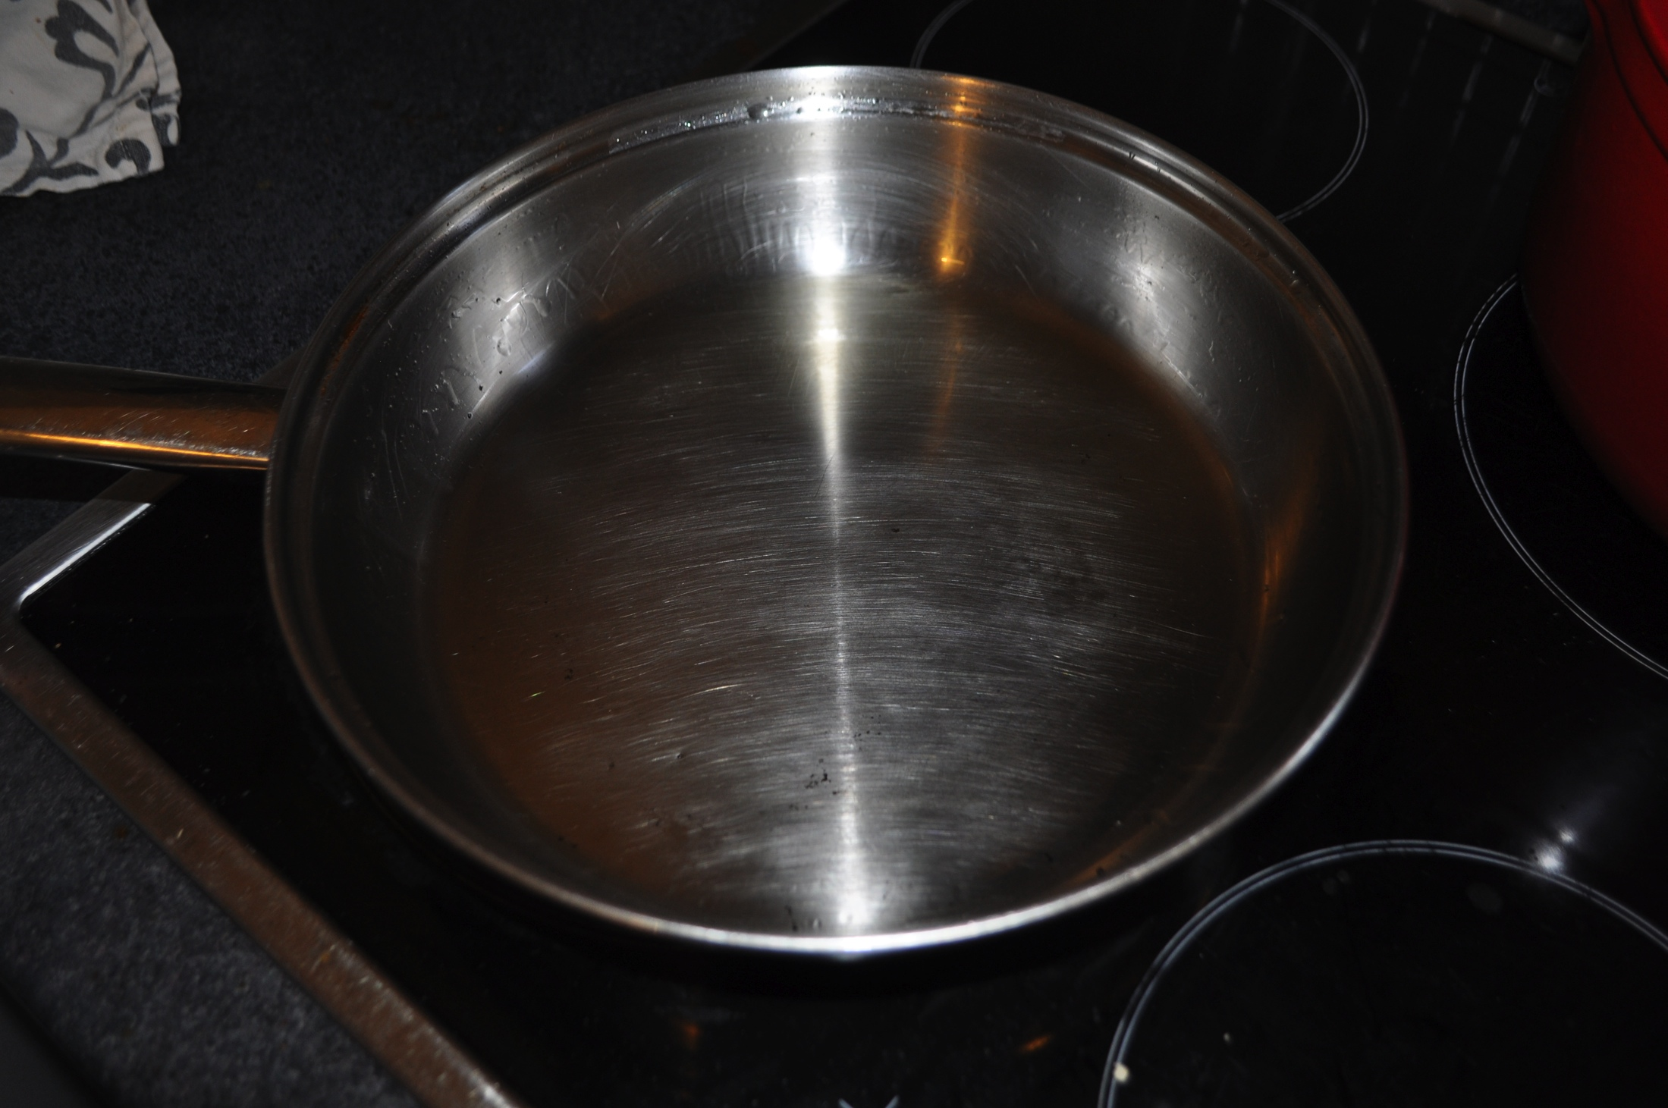
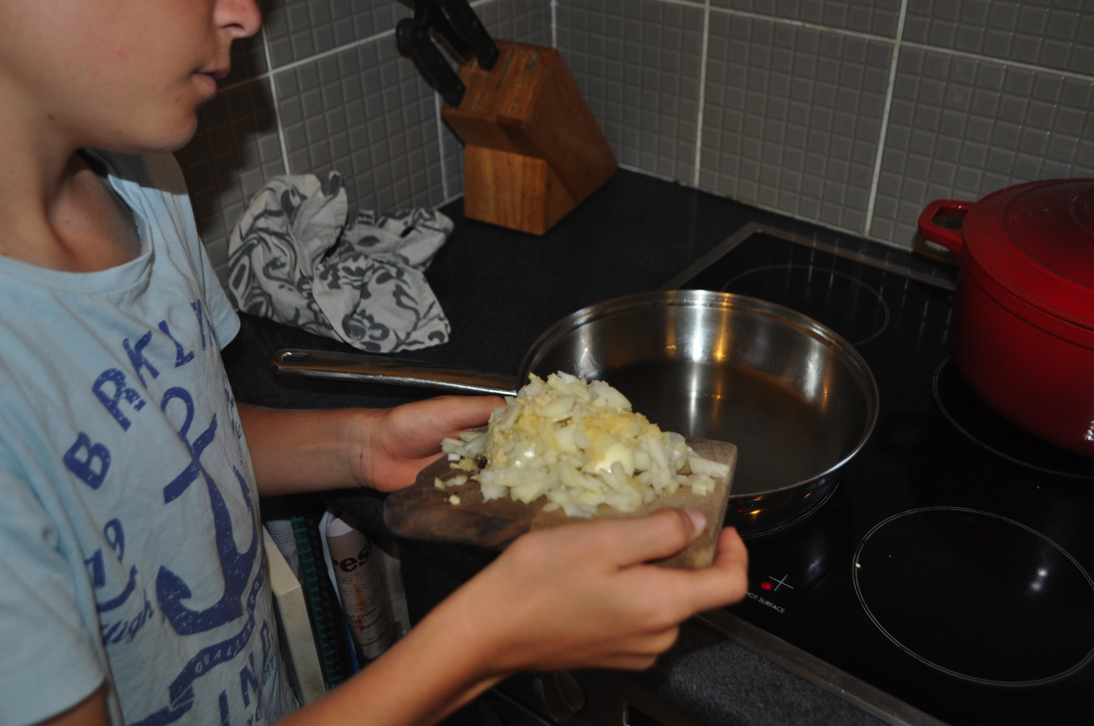
Step 6
Dice mushrooms
Step 7
Pour oil into frying pan and heat
Step 8
Put chopped onion, ginger and garlic into pan

Slide 9
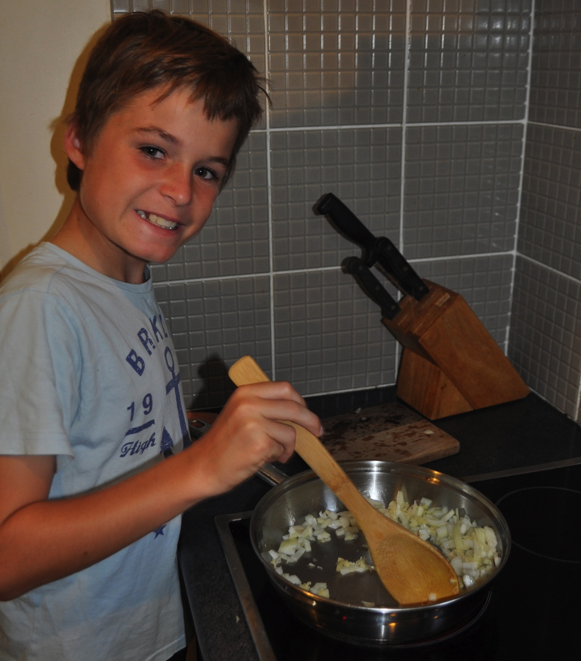
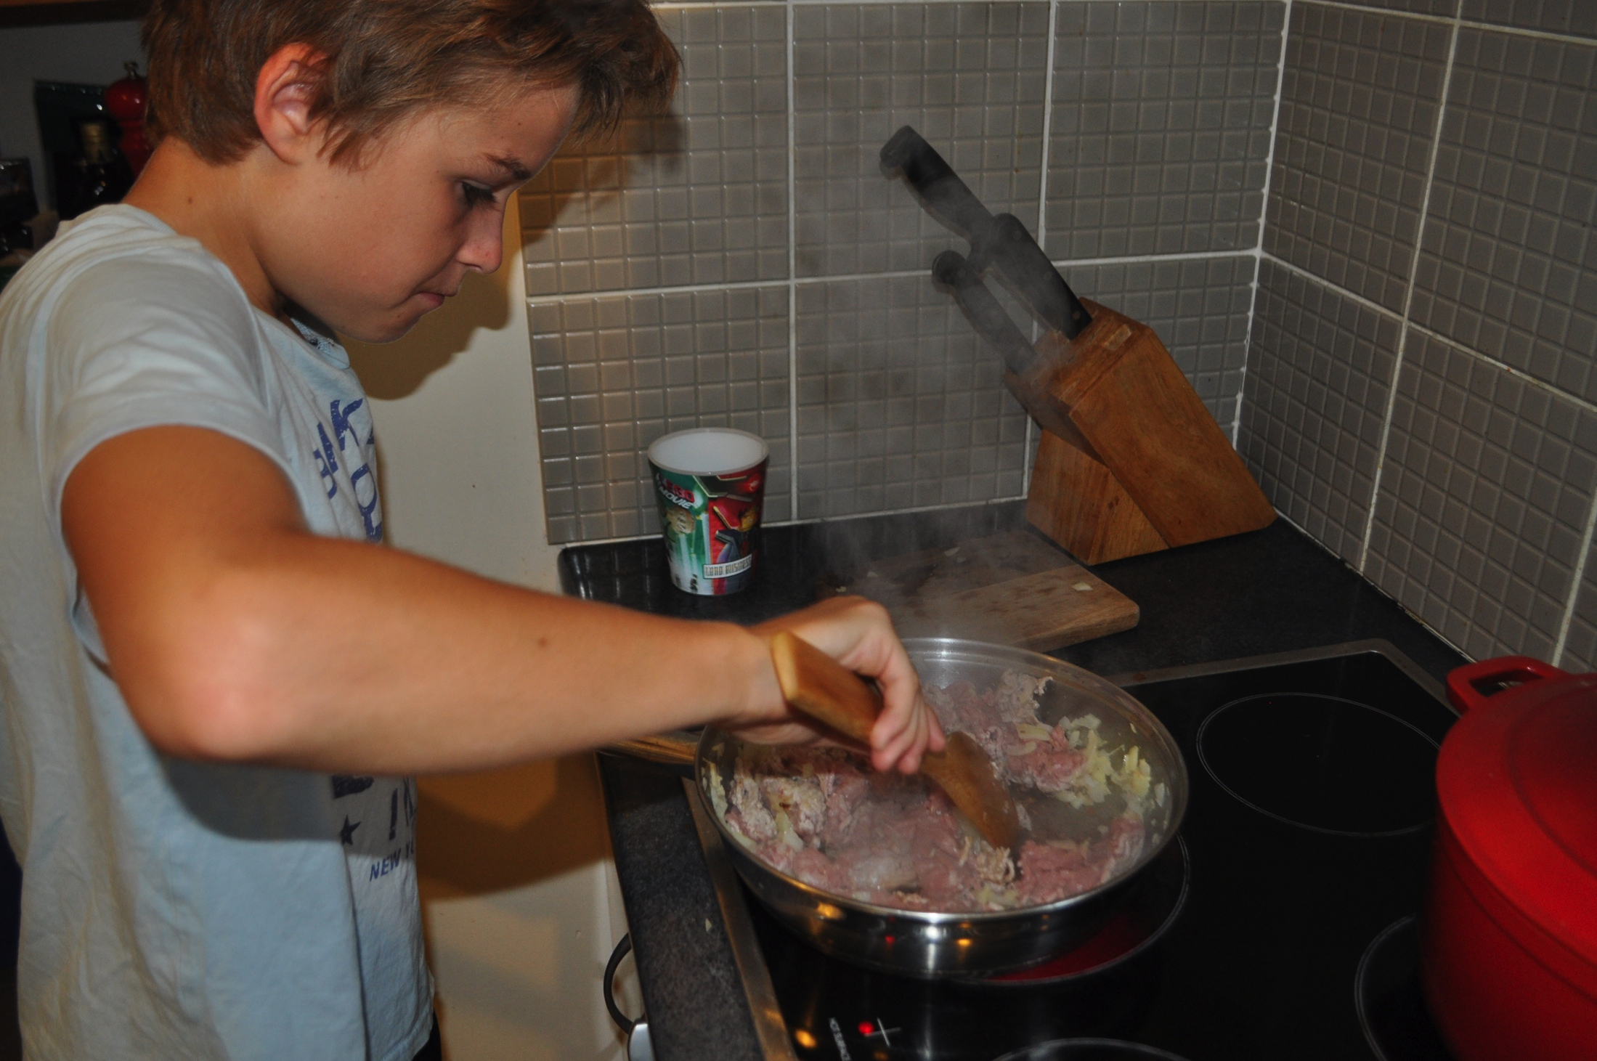
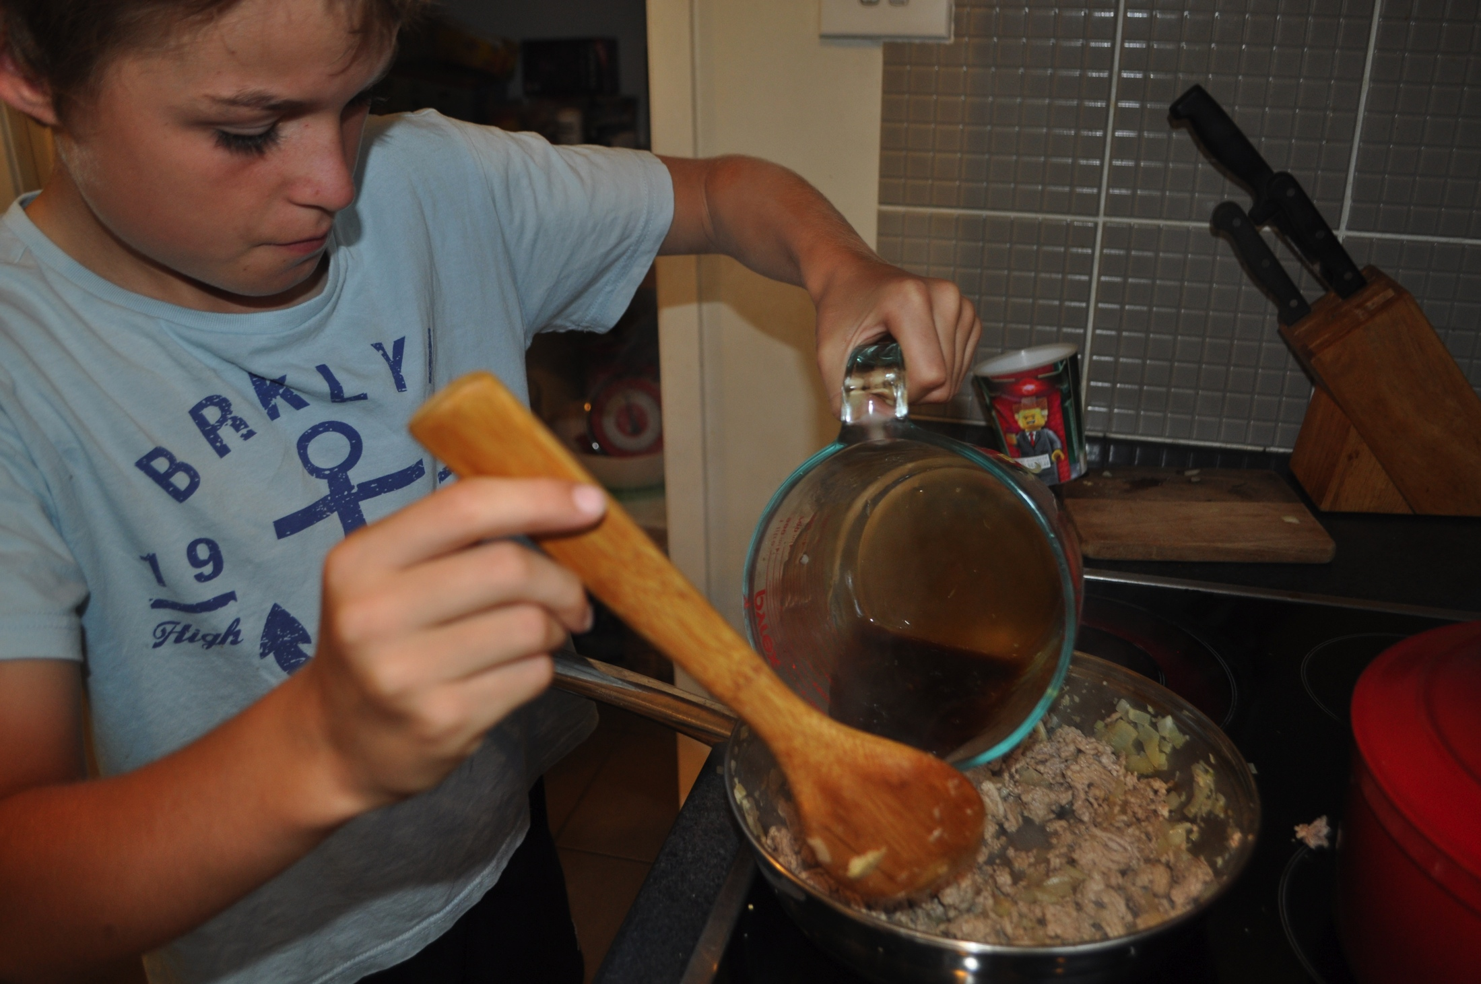
Step 9
Cook onion, garlic and ginger until transparent, stirring continuously
Step 10
Place mince into pan and cook until browned
Step 11
Pour in soy, oyster sauce and lime juice mixture into pan

Slide 10
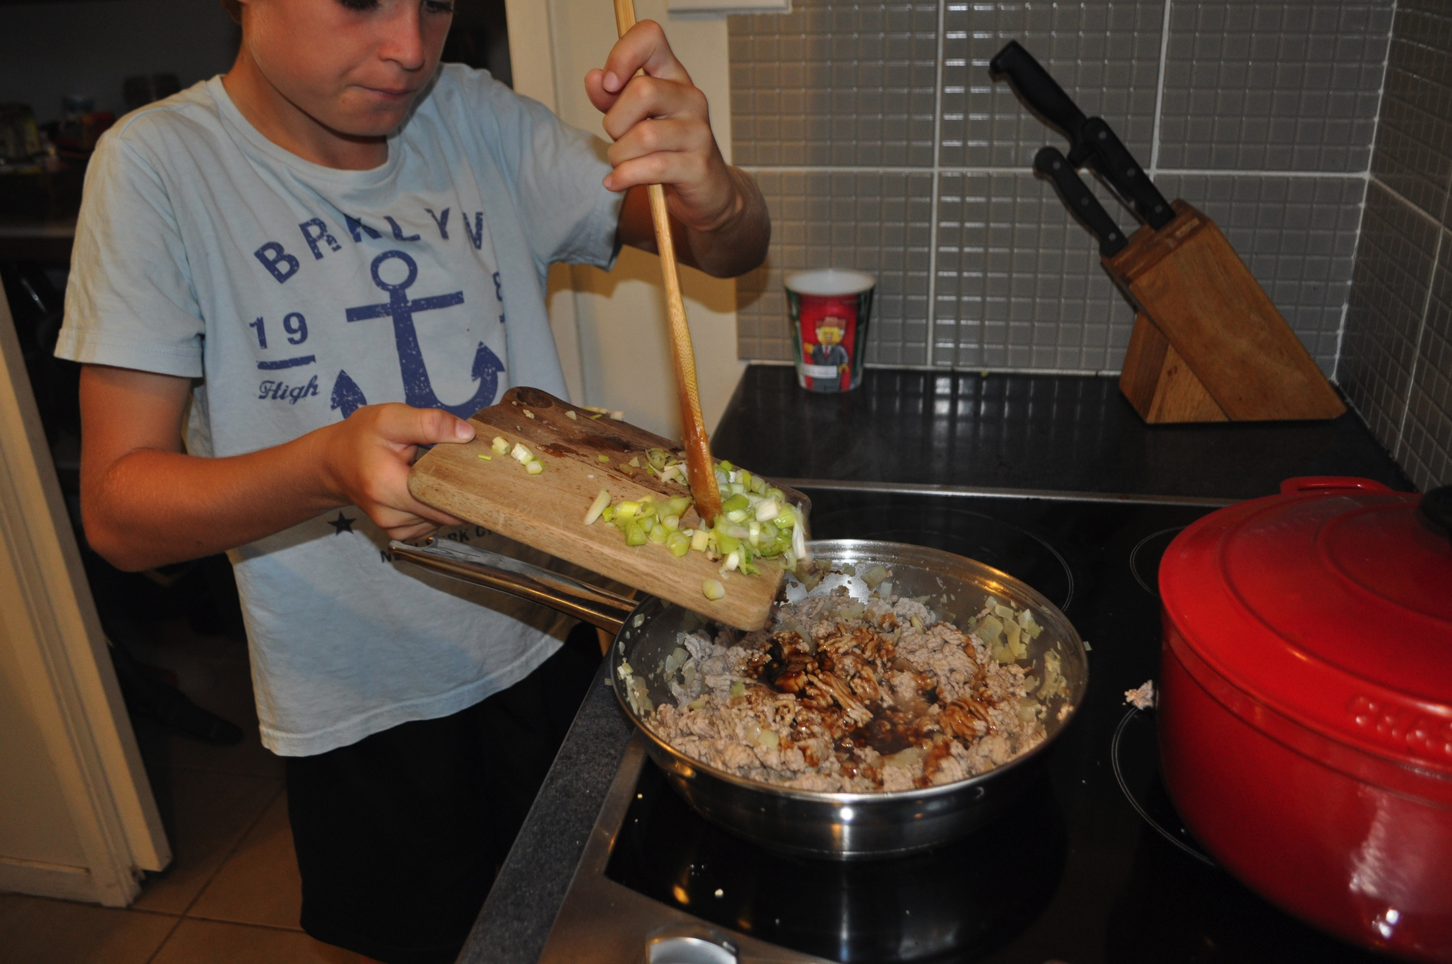
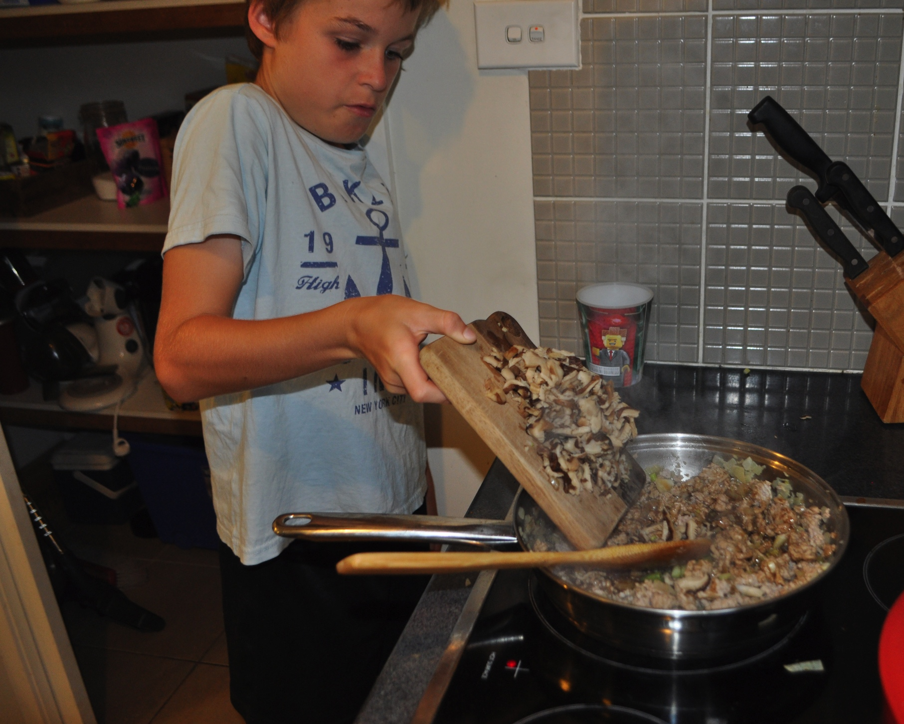
Step 12
Put shallots, coriander and shitake mushrooms into pan and give a good stir and cooking for a minute

Slide 11
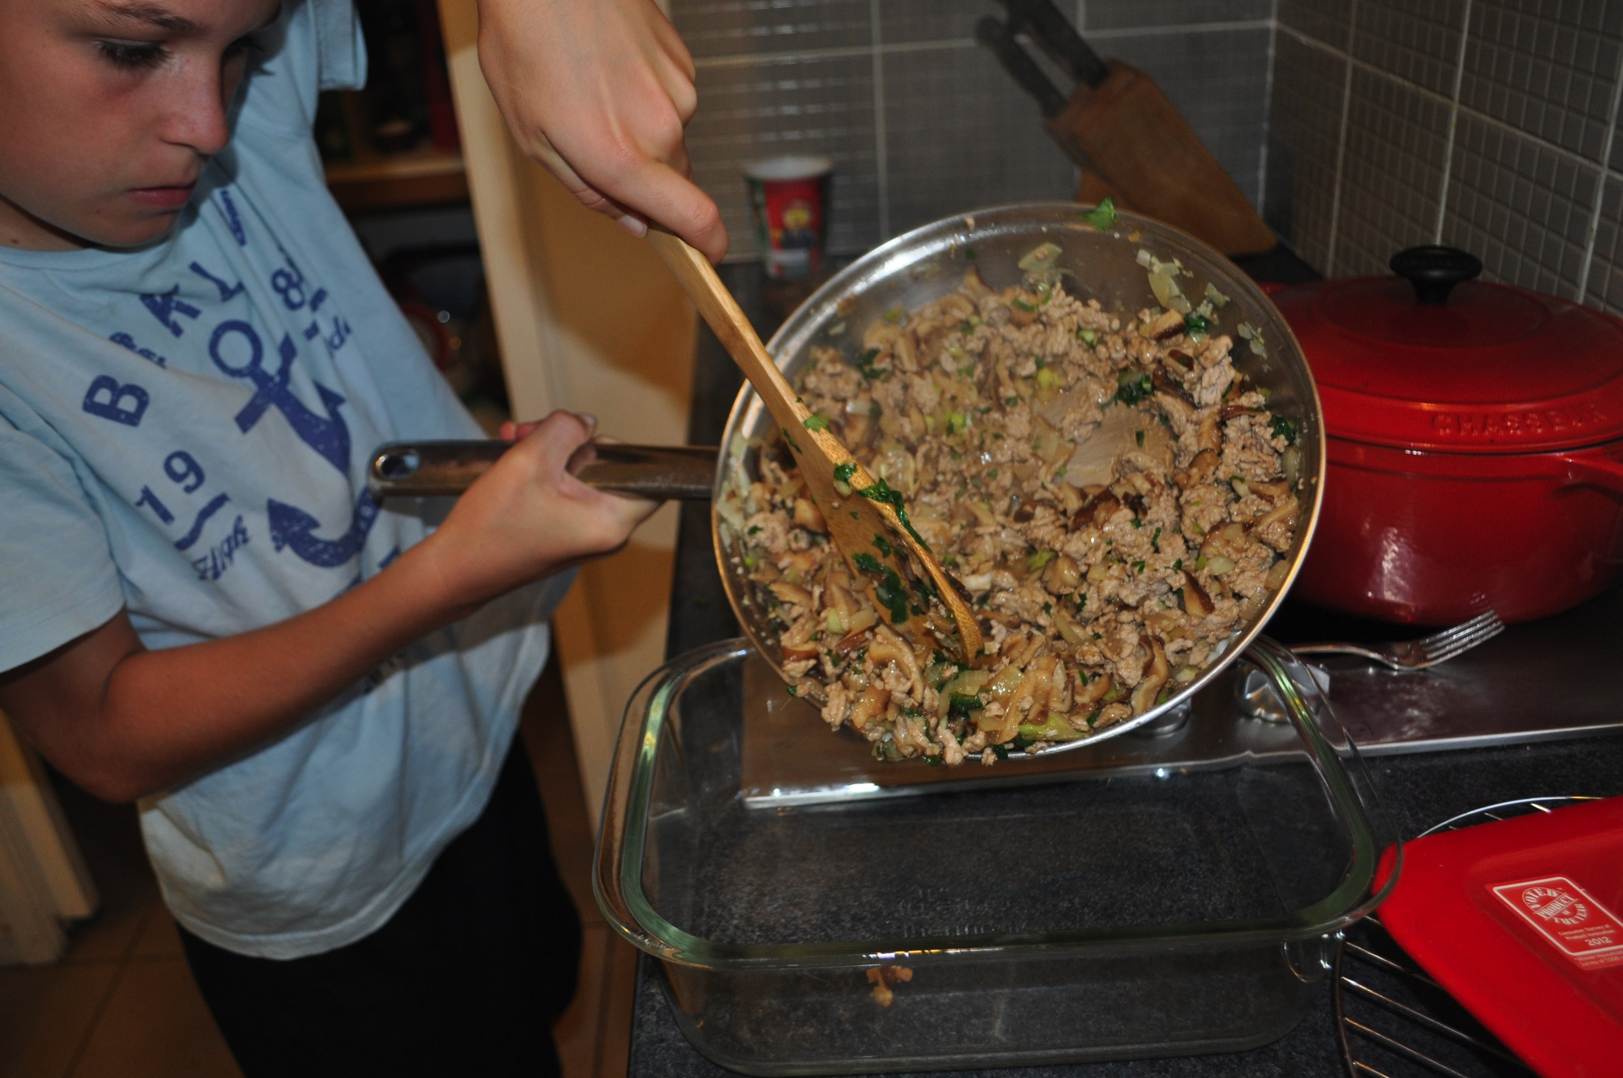
Put it all into dish and place into lettuce cups. I hope you all enjoy the taste of
SAN CHOY BAU!

