Slide 1
Maisie O’Connell
Term 1 Cooking Project

Slide 2
Ireland = Eire
Multicultural Cooking project with a recipe from....

Slide 3

Multicultural
Multicultural is where several ethnic groups or cultural groups exist within a society
Culture is the characteristics of a particular group of people

Slide 4
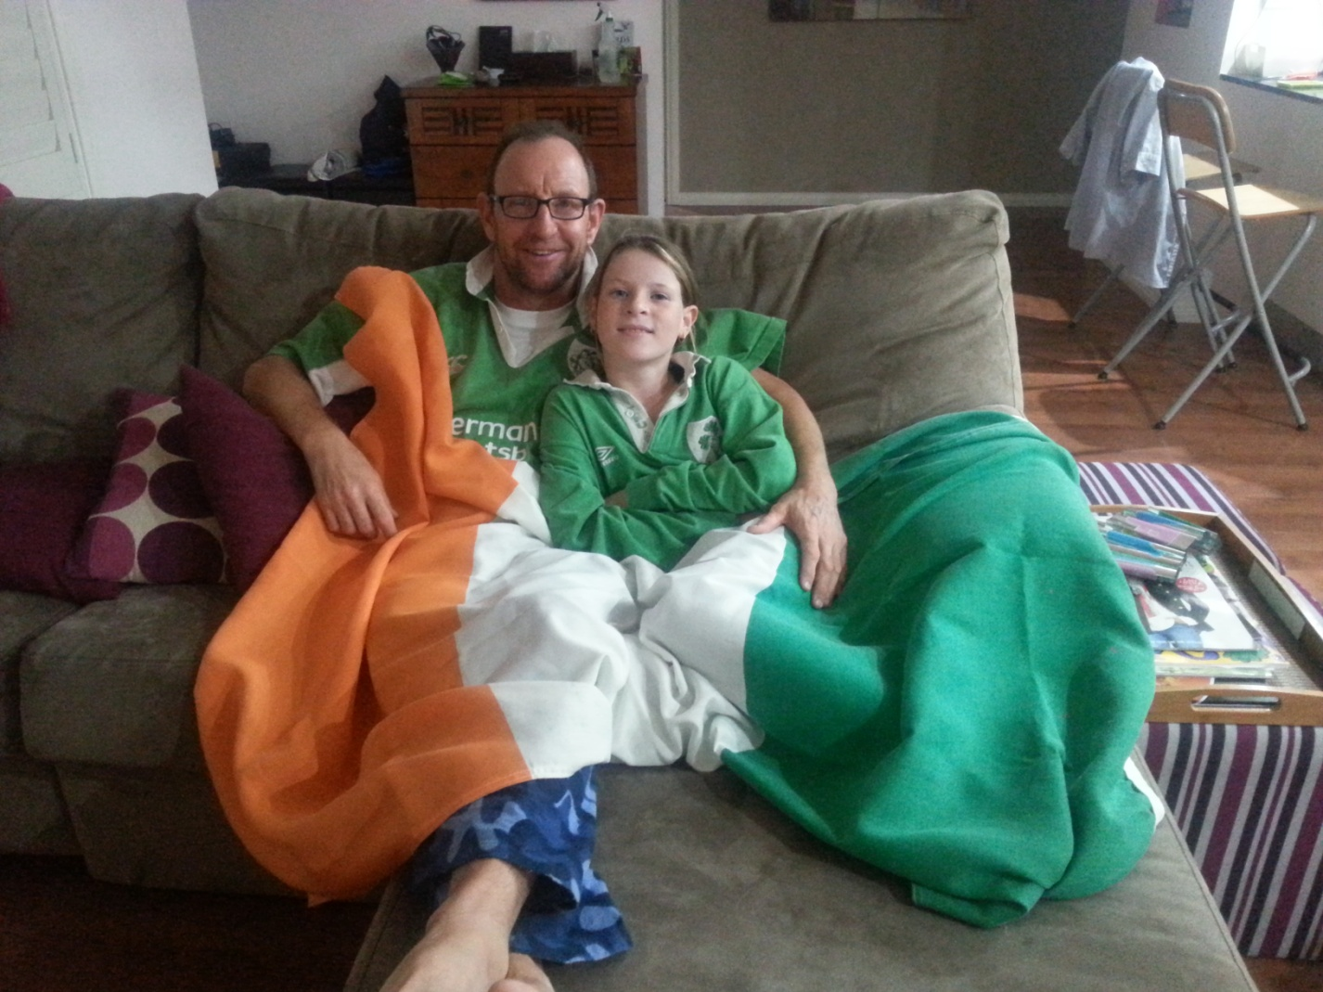
This is a picture of me and my Dad, he is Irish and grew up eating lots of potatoes!!
I LOVE MY DAD!!

Slide 5
About Ireland also known as Eire
Ireland is an island in the Atlantic Ocean next to the United Kingdom.
It is the third largest island in Europe.
Ireland is very green and has lots of lush pastures that grow vegetables and potatoes.
Potatoes have always been part of the Irish family’s staple diet.

Slide 6
My Chosen Cultural Background
The dish I have made is Irish Cheese and Potato Pie.
There are several variations in Ireland
This recipe or variation of is also common in Wales

Slide 7
Interesting History regarding the Potato
In 1845 there was a potato famine and many Irish people starved as there was nothing for them to eat, as the English took all the other crops away from the people.
The famine was due to a blight caused by a fungus that came all the way from Mexico.

Slide 8
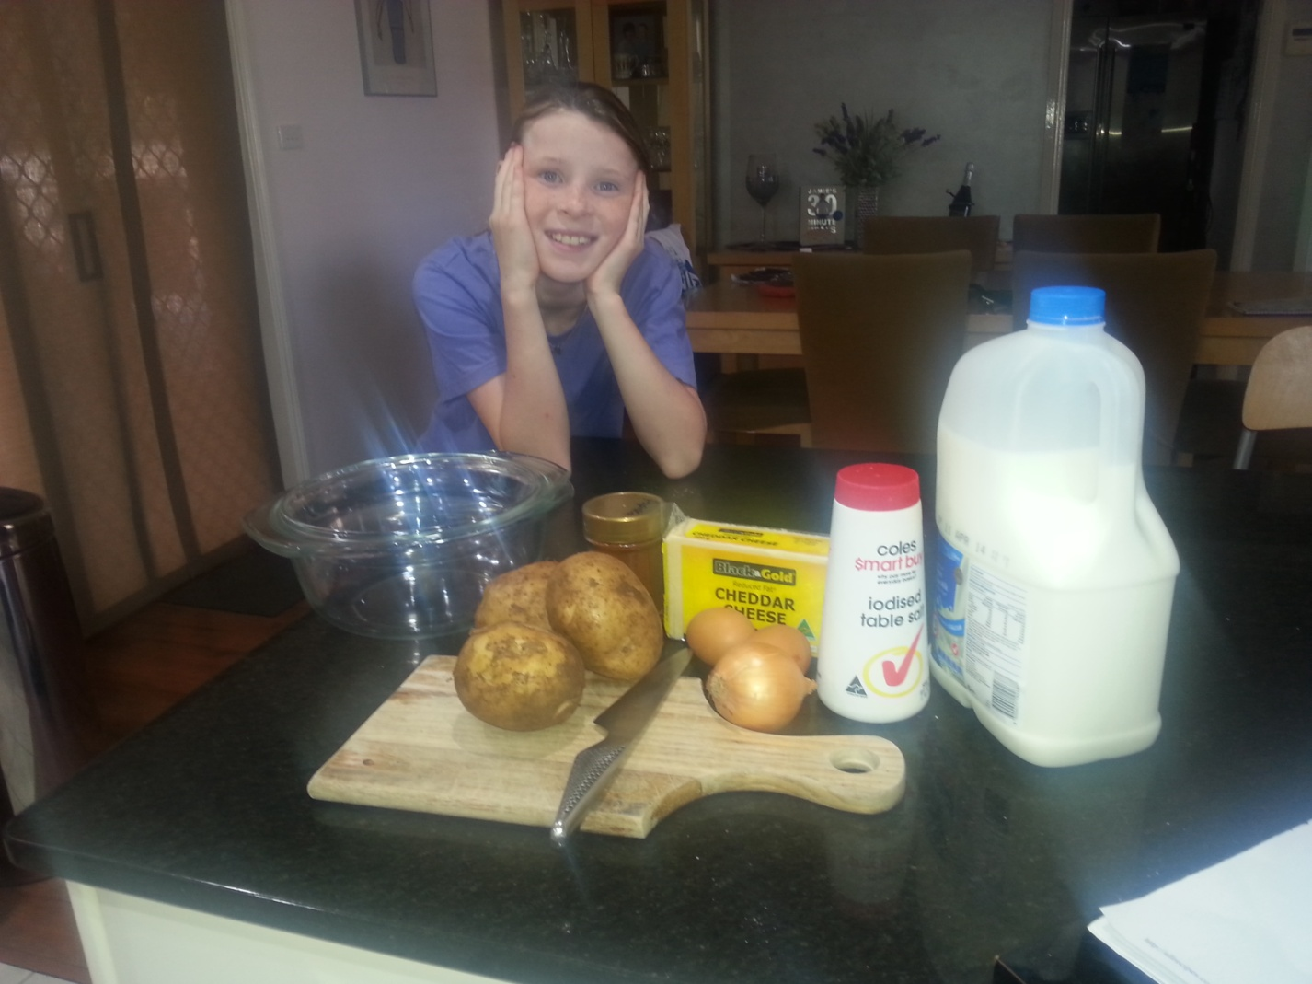
This is all the ingredients:-
Ingredients:-
Potatoes
Milk
Cheese
Onion
Salt
Butter

Slide 9
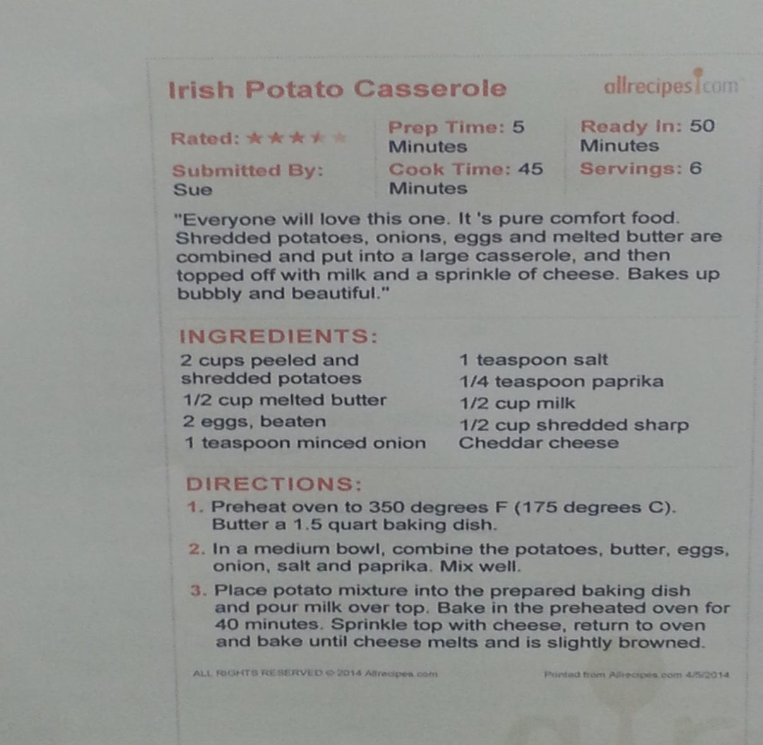
Recipe

Slide 10
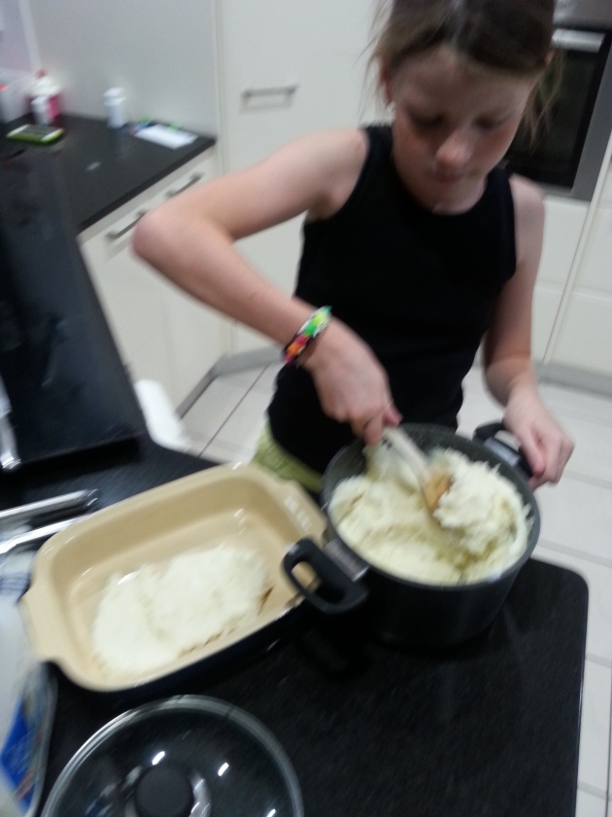
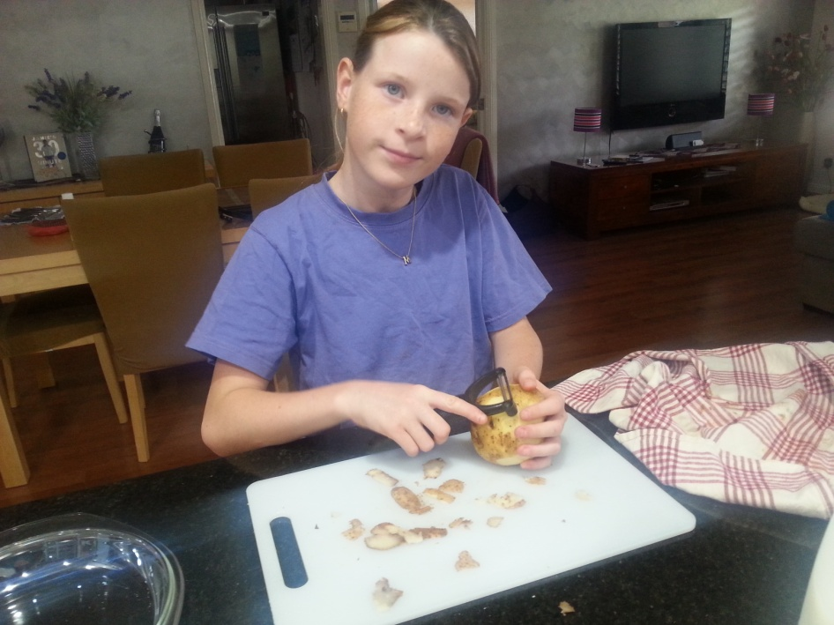
Now for the hard work...
Maisie in Action
Give it a good mix

Slide 11
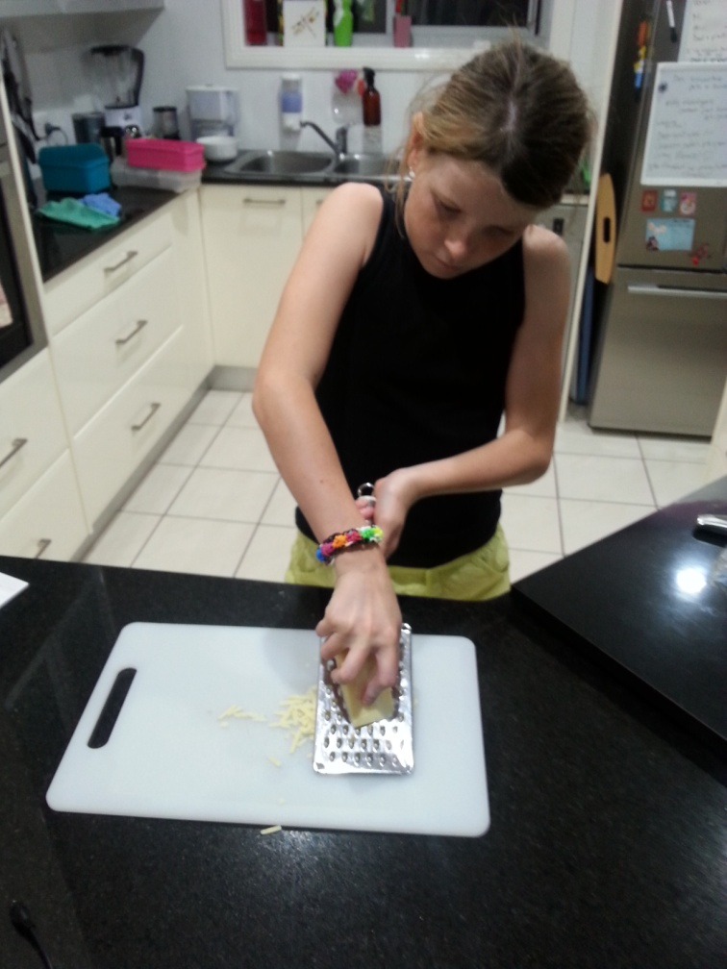
Grating the cheese....

Slide 12
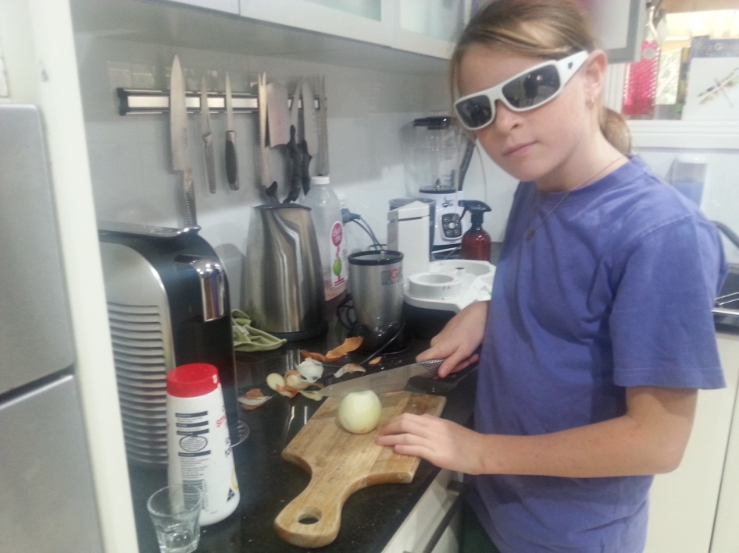
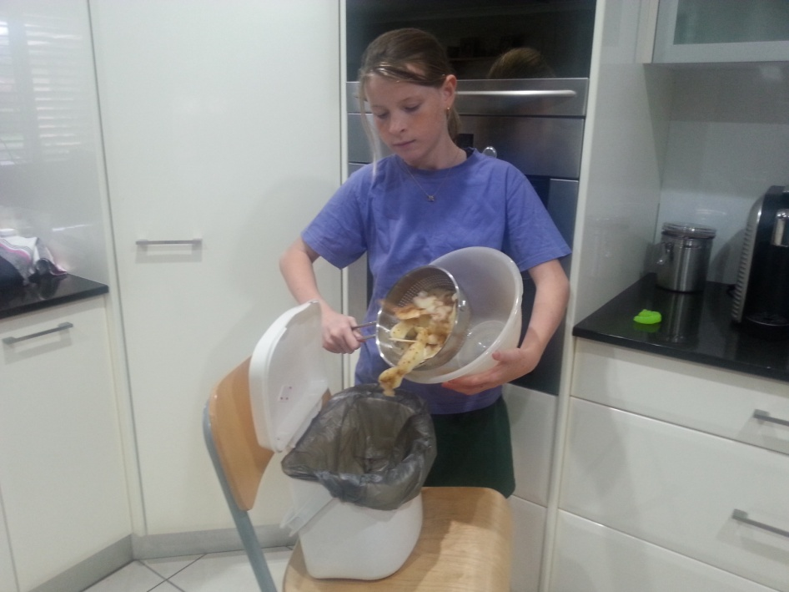
These onions sure make me cry...into the compost go the peelings
Cool!
Yuck!

Slide 13

And finally......
These days the people of Ireland have recovered from those grim times and people are healthy and still love their potatoes!
I hope you enjoyed my cooking project presentation and enjoy a taste of Ireland history.

Slide 14
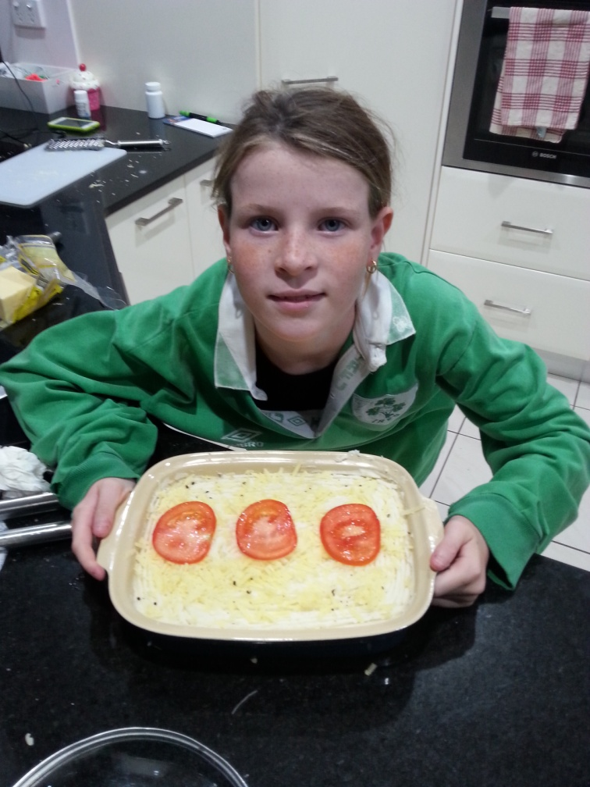
Irish Cheese and Potato Pie

